Slide 1

Six Weeks in Reception
What have been the positives about your child’s transition to school?
How has your child’s transition to school been?

Slide 2
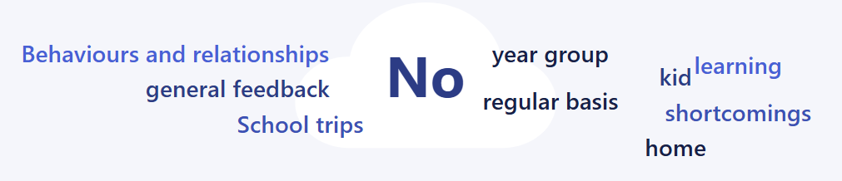

Slide 3
Our Reception Ethos
What happens early, matters for a lifetime
We want children to be highly motivated, inquisitive and independent learners
We help children to build strong foundations of knowledge and skills, which builds on what the children know, can remember and do
We are ambitious and staff are highly skilled to provide challenge
We promote a love of learning through practical and first-hand experiences
Play based learning

Slide 4
We build upon the foundations of your child’s learning in Nursery…
Nursery provision | School provision
Ratio of adults 1:8 (or 1:5 for Level 2 trained staff or under 2s) | Ratio of adults 1:30 We are very lucky to have teaching assistants to support in class- typically this would be one per class
Communication books or a one-to-one handover at the end of the day | This is not typical in a school environment. With 30 children going home at the same time, we are unable to do a handover with each parent. We use Class Dojo to communicate main messages to parents and to give a general update about what we have been learning.
Diary of what your child has eaten at nursery | Teachers stay in the hall to settle the children to eat their lunch. They do not stay with them for the whole of the lunch break. We have midday meal supervisors to monitor and provide support where needed. Children go outside on the playground once they have eaten, with the whole school. They are supervised by teaching assistants (normally 4 or 5 adults).
One-to-one key worker meetings | We hold two parents evenings a year where you can make an appointment to have a 10 minute meeting with your child’s class teacher to find out about their progress. We write a formal written report at the end of the school year.

Slide 5
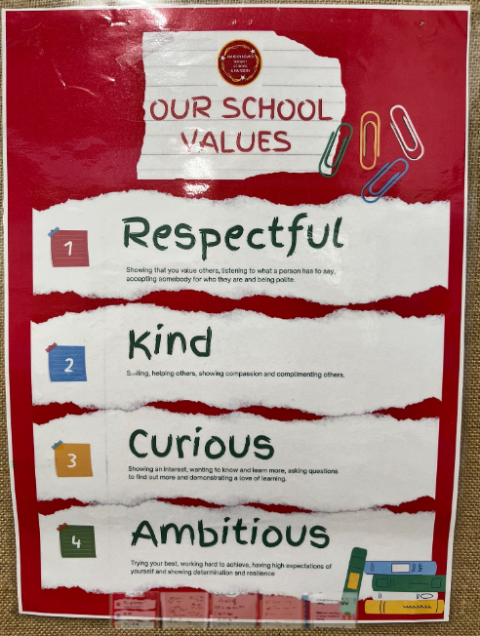
Our school values are displayed around the school. We refer to these in our learning time and our assemblies are also linked to our school values.
Every Friday after half term, we will attend a whole school celebration assembly where we award one child from each class who has been working hard to demonstrate a school value. Every child will get the certificate at some point over the year!

Slide 6
Personal, Social and Emotional Development
At school, your child will learn how to behave and be sociable with many children- we have 71 children in Reception!
Children’s personalities vary- as do adults!
PSED is a key part of our learning experiences in Reception
We create class valued behaviours at the beginning of the year
The children in Reception are 4 and 5 years old- we don’t expect them to be socially and emotionally mature- that is what we teach them at school, with your help and support at home
You can support your child by reinforcing the school valued behaviours, building up independence and encouraging your child to let an adult know if they need help

Slide 7
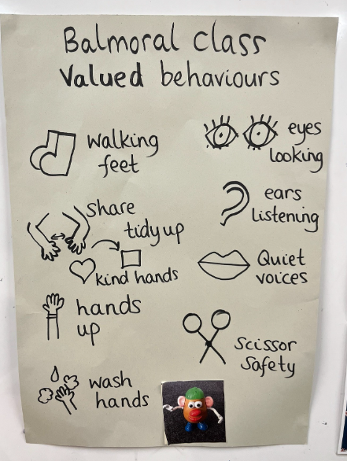
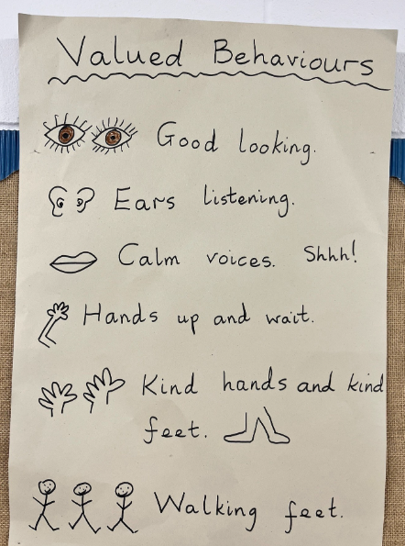
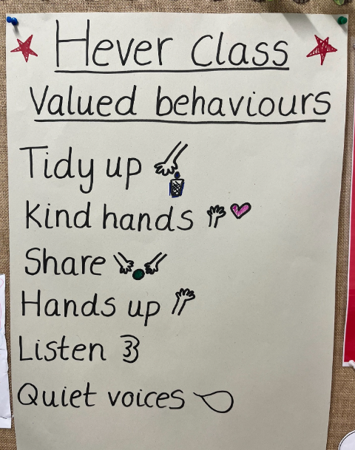

Slide 8
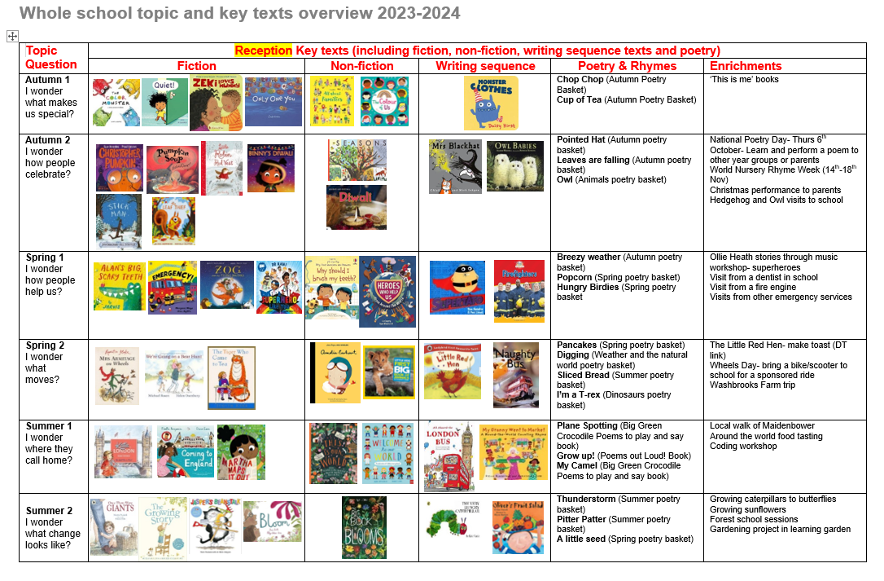

Slide 9
How does my child learn in Reception?
Reception children learn through a balance of whole class teaching, small group work, one to one support and through child-initiated play opportunities.
We value the importance of play. At school, we call this time of day ‘discovery time’ where the children choose their learning. Adults interact with the children through their play.
Personal, Social and Emotional Development learning is always happening through play.

Slide 10
Structured learning time
(Whole class, group work, one to one work)

Slide 11
Discovery time
(Play and child-initiated learning)

Slide 14
Our morning
8:40-8:50am- Welcome time (we do yoga, choose a story to read or practise skills such as writing the sounds we have learnt in phonics)
9-9:20am- Input (this is themed to a key text or topic)
9:20-11:15am- Discovery time and tidy up time
(On Fridays, we join Year 1 and 2 for assembly in the hall)
11:15-11:40am- Phonics
11:45am- Lunch time in the main hall

Slide 15
Our afternoon
12:10pm- Outside play on the playground
1-1:30pm- Reading carousel
Reading groups with our teacher and teaching assistants (3x a week)
Dough disco/handwriting
Input (linked to a key text or topic)
1:30-2:30pm- Discovery time and tidy up time
2:30-3pm- Story/poetry and get ready to go home

Slide 16

We will feed back to you about your child’s progress through two parents evenings in the Autumn and Spring term and a formal report at the end of the school year in the Summer term.
We will also share your child’s learning through the website and app Class Dojo. This will be by our Early Years staff sharing photos of learning and activities on the main ‘Class Story’ and by sharing your child’s personal achievements through photos or comments via your child’s portfolio on Class Dojo.
PLEASE NOTE WE DO NOT USE THE PRIVATE MESSAGE OPTION- if you wish to pass on a message to your child’s teacher, please email the school office.

Slide 17
How will your child learn to read?

Slide 18
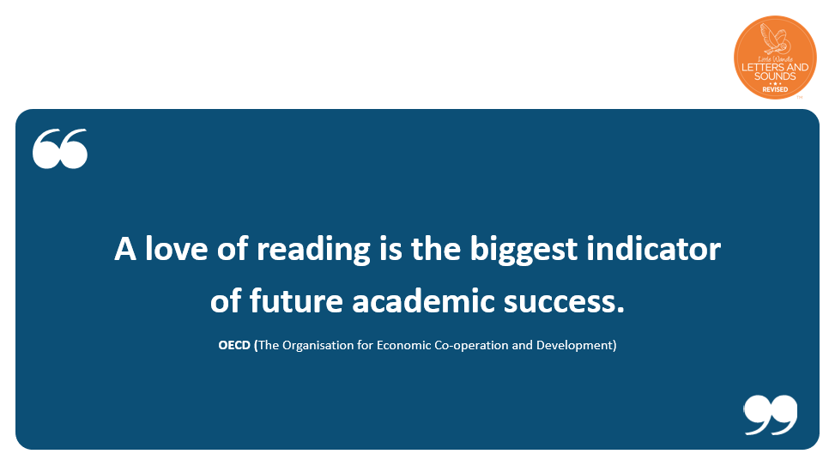

Slide 19
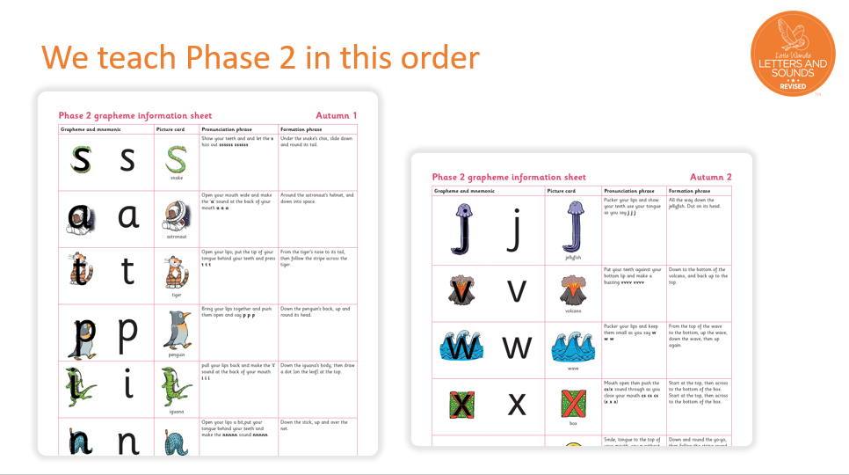

Slide 20


Reading a book at the right level
This means that your child should:
know all the sounds and tricky words in their phonics book well
be able to sound talk and blend some simple CVC words
identify the sounds in words by segmenting and then blending the sounds together to read words
talk about the events/pictures/what they have read
Notes:
Slide purpose:
To introduce book matching
Suggested script:
Whilst your child is learning Phase 3 GPCs they will be reading a Phase 2 book – as these books are at their level of security.
Once they have secured the Phase 3 GPCs and read them in words confidently, they will read a Phase 3 book.
In these books we encourage them to ‘blend in their heads’. This is a strategy that helps children to become fluent readers.
Blending in your head means children say the sounds quietly in their heads and then read the whole word out loud. Eventually, this will become automatic and children can read words that they know fluently.
We will always communicate with you if we feel that your child is not blending accurately enough yet and needs additional support.

Slide 21


Books going home
Notes:
Slide purpose:
To introduce the process and format for reading at home
Suggested script:
As well as the ‘learning to read’ book that your child will bring home they will also bring home a book for sharing with you.
This shared book is SO important. This is how we are going to give them the WILL to read.
Please read with your child as often as you can – at least once a day if possible.

Slide 22
How will my child learn to write?
Your child will learn to write letters, words and sentences in Reception.
We keep writing sessions positive and short (if your child feels that they can succeed, they will be more confident and willing to write!)
We learn to make marks and write individual letters first
Putting meaning to marks is key
We encourage children to segment and blend the sounds in words
We move on to writing CVC words and short sentences e.g. ‘sun’ or ‘it is a sun’
We write in lower case and teach capital letters for the beginning of sentences and/or names.

Slide 23
We then move on to writing longer words and sentences where children will rely on their phonic knowledge to help them spell words e.g.
I luv my bruver and mi pet dog.
I wnt too the prk and I wet swimming at the week end.
The cat haz wiskers and fluffee fur.

Slide 24


We encourage the children to write down the sounds they can hear- this does not need to be perfectly spelt- this is really important!
It is ok for your child to spell like this:
hoam home
hom hm
We sound out words using our ‘segmenting fingers’
Your child will learn the correct spellings as they learn more phonics, read and write! We expect children to write using the sounds they have learnt so far in phonics, wherever that is on their reading and writing journey!

Slide 25
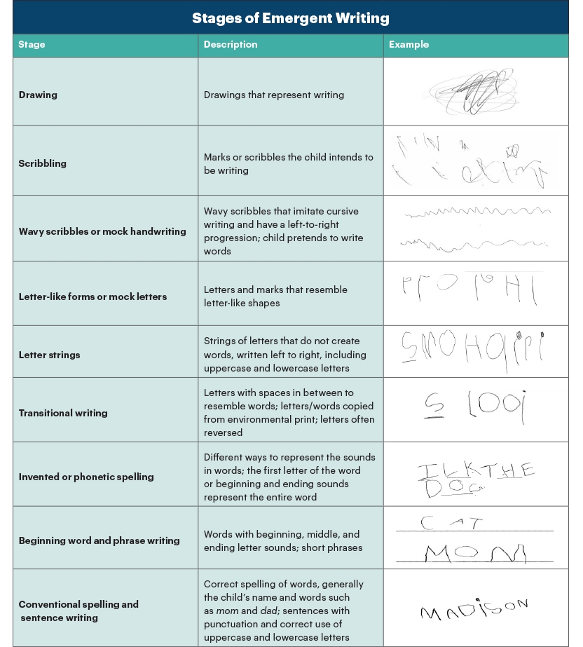

Slide 26

How will my child learn maths?
We follow the NCETM Mastering Number programme
The programme is designed to ‘dig deeper’ and have a mastery knowledge of numbers to 10. It is not about knowing bigger numbers!
Maths sessions are short and pacey, 10 minutes a day.
We focus on a shape, space or measures maths objective each week alongside ‘Mastering Number’.
Children have the opportunity to rehearse learnt maths skills in discovery time.
We have had lots of success with the Mastering Number programme over previous years! The programme continues into Year 1 and 2.

Slide 27
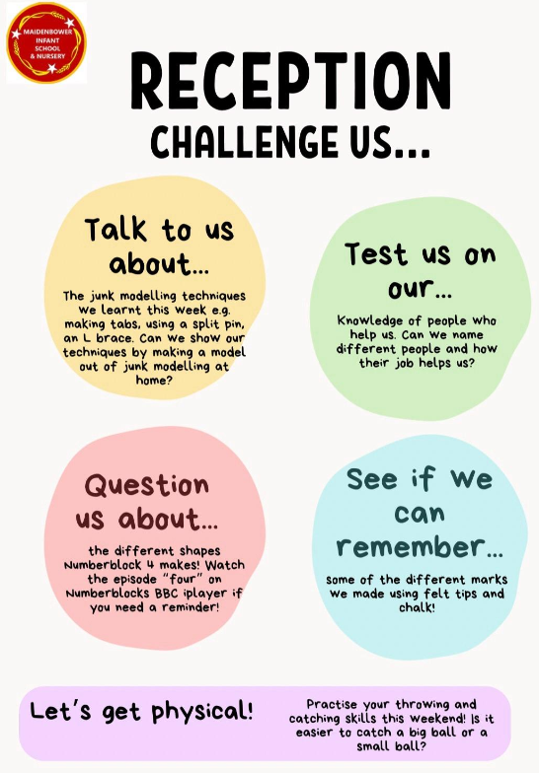
How can I support my child at home?
Play with your child. Model language and provide quality interactions
Read every day! This can be listening to your child read to you or you reading stories to your child
Little and often- 5-10 minutes is enough
Share ‘wow’ moments on Class Dojo
Phonics home learning
Take part in home learning activities on the ‘Challenge Us’ poster
Engage in the learning we are taking part in and showing on Class Dojo- talk to your child about the photos ☺

Slide 28

Thank you for coming!
Any questions or feedback?

