Slide 1

Welcome to
Maidenbower Infant School and Nursery

Slide 2
Meet the team
Class Teachers
Miss Lea Kelly/Mrs Coral Carter – Hever Class
Mrs Tory Hoyland – Amberley Class
Miss Amber Munday – Balmoral Class
Teaching Assistants
Mrs Carrie Tarran
Mrs Karen Wilson
Miss Kate Gray
Mrs Laura Roberts
Headteacher
Mrs Rachel Tomlinson
Assistant Headteacher for Inclusion
Miss Lea Kelly
Assistant Headteacher for Teaching and Learning and EYFS

Slide 3
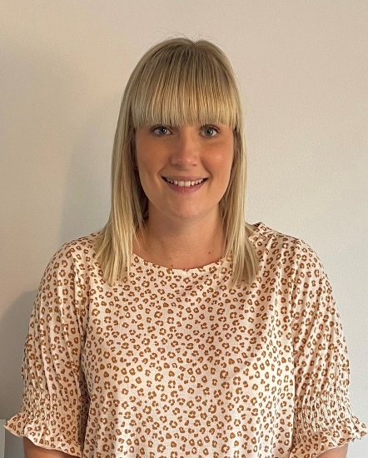
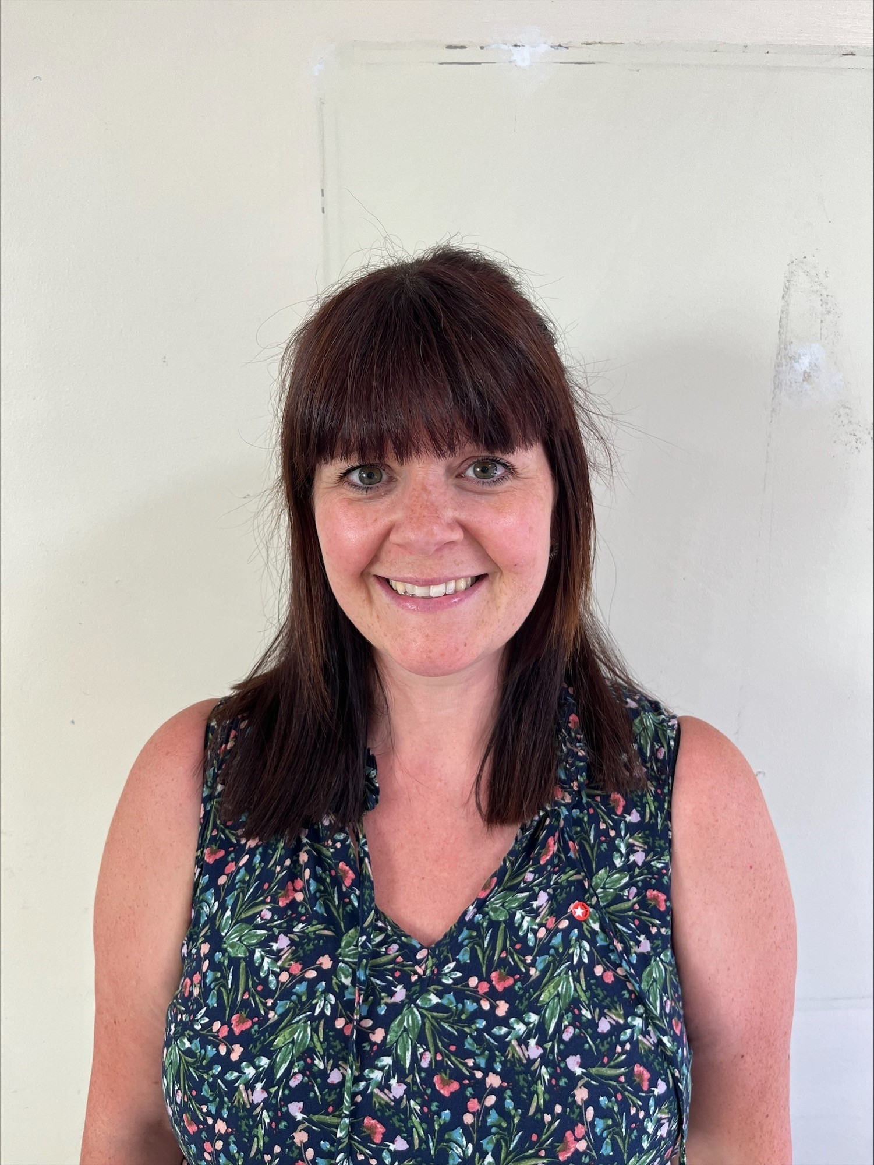
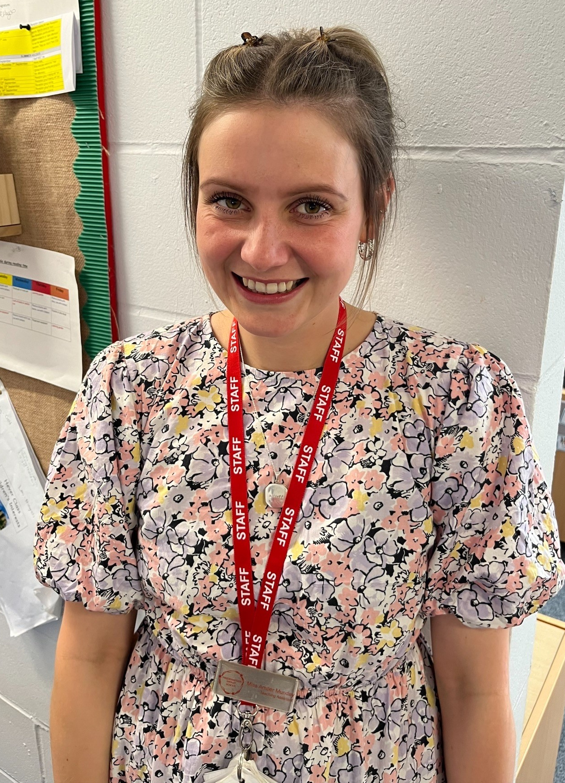
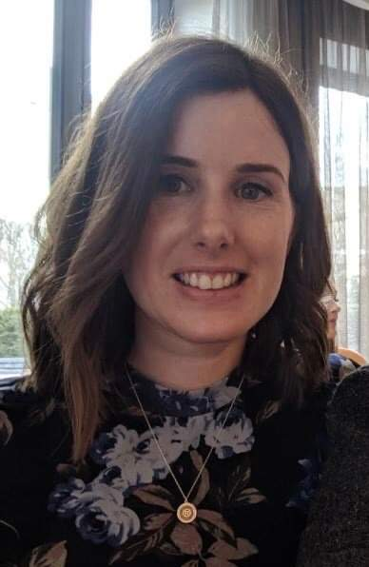
The Reception Team
Class Teachers
Miss Lea Kelly
Mrs Coral Carter
Miss Munday
Mrs Tory Hoyland
Balmoral Class
Amberley Class
Hever Class

Slide 4
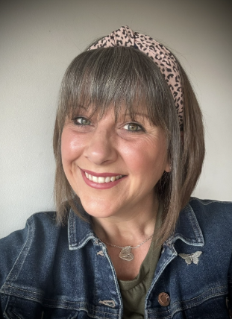
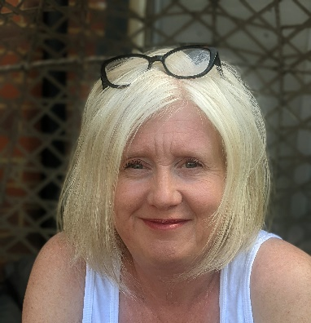
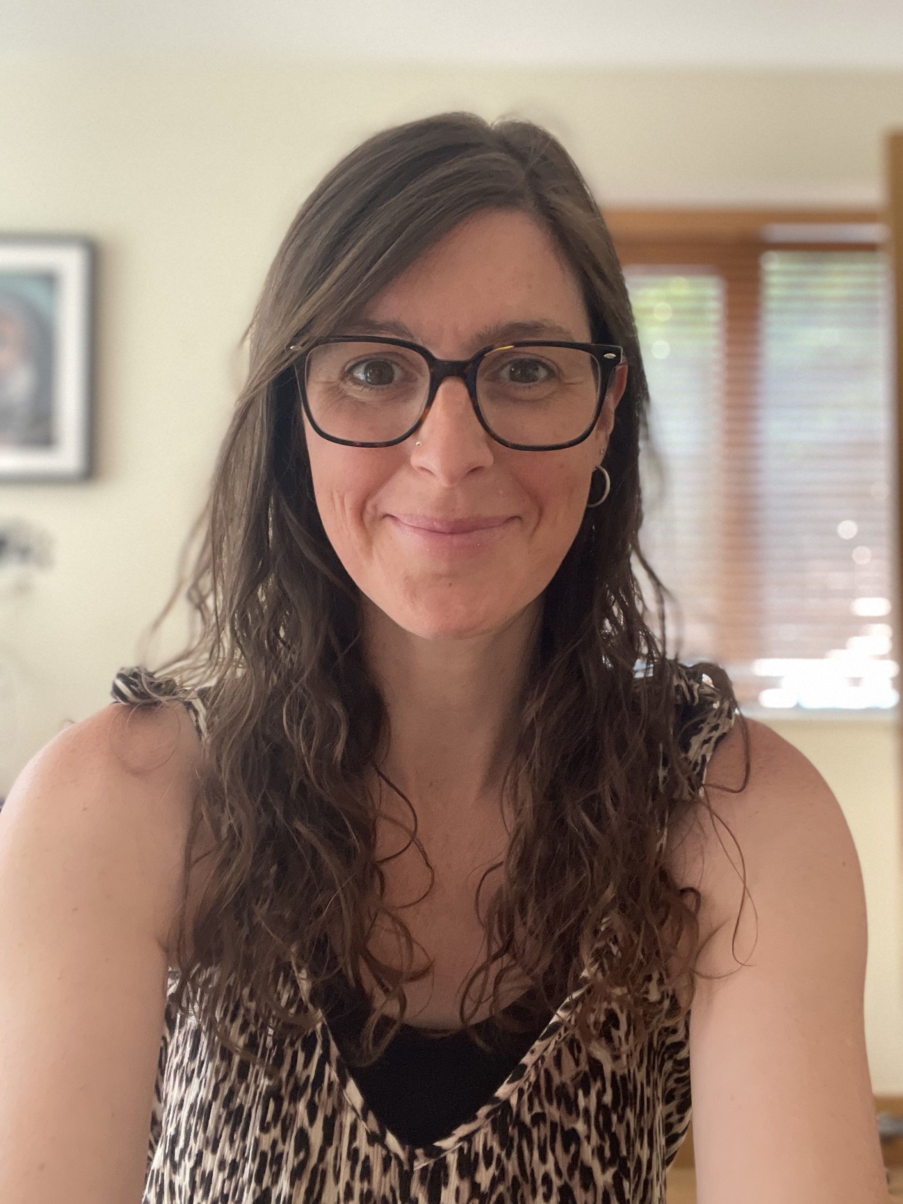
The Reception Team
Teaching Assistants
Mrs Karen Wilson
Miss Kate Gray
Mrs Carrie Tarran

Slide 5

Starting school in Reception
Pack
Visit

Slide 6


Slide 7
How can you prepare your child for school?
Getting dressed and undressed/putting on shoes
Putting on and zipping up a coat (gloves & wellies)
Recognising their name (so they can independently find their jumper and belongings)
Using a knife and fork
Using the toilet independently
Using their water bottle
Manners – Please and Thank you!
Remember there is one teacher for all children in the class.

Slide 8
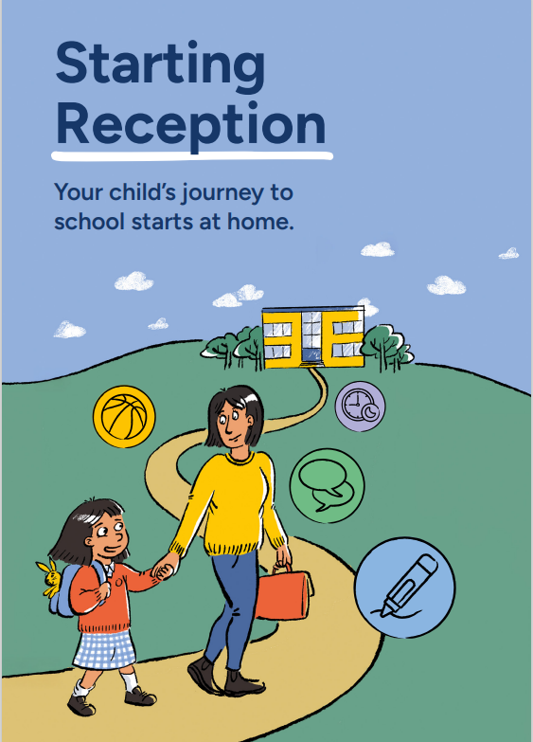
You will find this leaflet inside your packs

Slide 9
School Uniform
Red or white Polo shirt
Red sweatshirt/cardigan
Grey or black trousers/shorts/pinafore/skirt
Red check summer dress
Black school shoes – no laces!
PE shorts (black)
PE T-shirt (red or white)
Plus
Book bag
Water bottle
Please name everything!

Slide 10

Absence
If your child is unwell, please telephone the School Office in the morning to confirm reason for absence
Medical problems/allergies…let us know
Medicine in school - inhalers and epi-pens; infant paracetamol & Piriton
Attendance is Important!

Slide 11
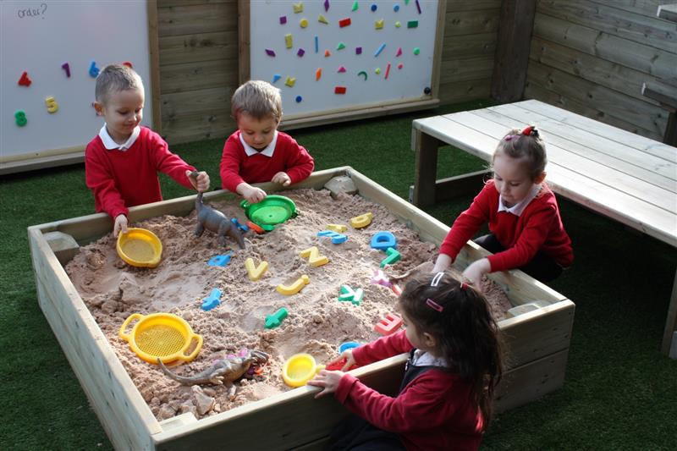
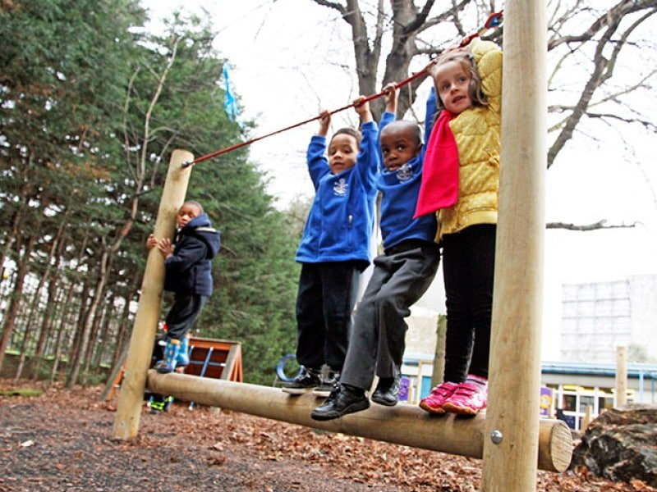
In Reception we learn through Play!
Learning through play is an important part of a child’s early development.
Playing helps young children’s brains to develop and their language and communication skills to mature.
Play gives children the opportunity to actively explore the world around them.
Play is one of the essential ways in which young children gain essential knowledge and skills.

Slide 12
Through play, children develop skills in the following areas:
Personal, Social and Emotional Development
Communication and Language
Physical Development
Literacy
Mathematics
Understanding the World
Expressive Art and Design

Slide 13
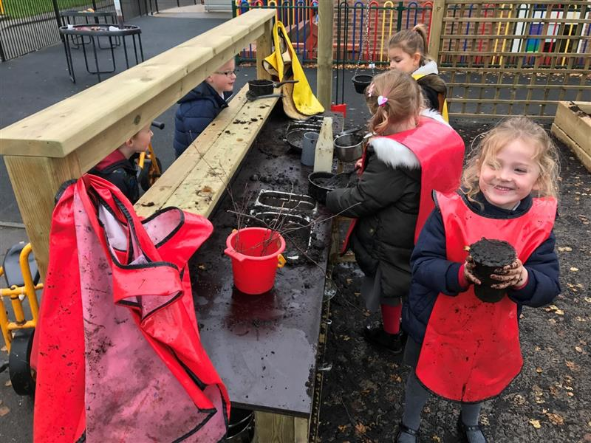
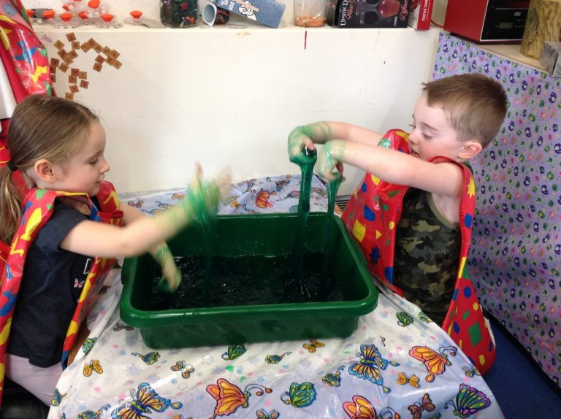
What does learning through play look like at school?
Children will be encouraged to select their own learning through play-based activities.
Children will have the opportunity to learn inside and outside every day, in all weather!
Toys/resources are displayed easily for children to access independently.
Teachers plan play-based activities to support children’s next steps and to provide new learning experiences and challenge.

Slide 14
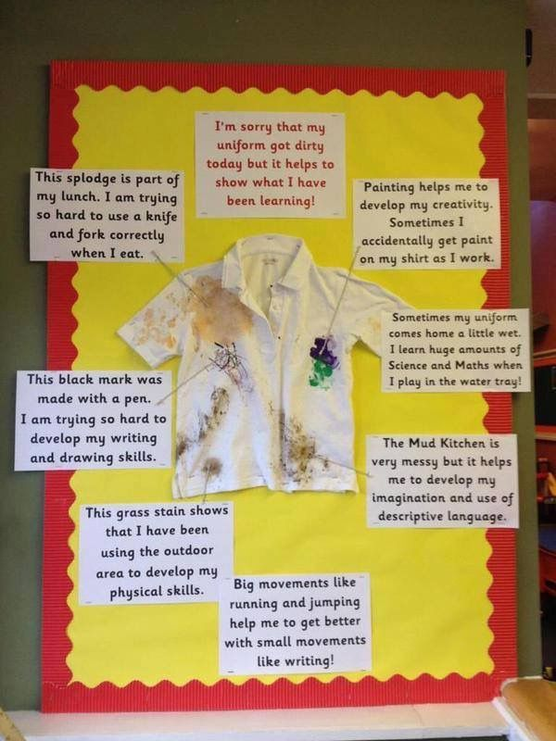
Sometimes learning through play can be messy! If your child comes home with dirty clothes, it usually means that they have had a fun day of learning! ☺

Slide 15
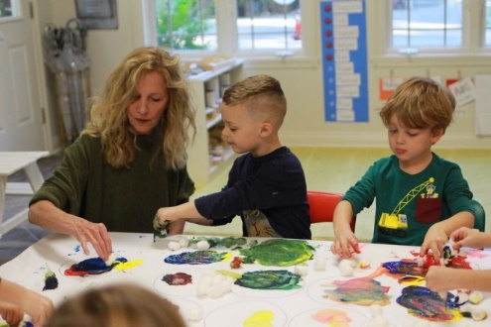
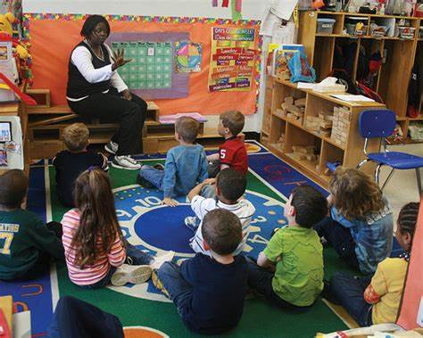
What do the teachers do at school?
In Reception, the adults will play alongside children and:
Model
Support
Encourage
Observe
Assess
Every day your child will take part in a learning activities with the whole class on the carpet. They may also work with an adult at a play-based task on their own or in a small group.

Slide 16

Transition
Open morning Wednesday 2nd July 9:30-10:15am
Teacher home visits
Staggered starts in small groups
All the children in together after the first week
Individualised transition plans to suit your child's needs

Slide 17

How do we communicate with parents?
As most of the learning in Reception is practical and play based, the children do not record their learning in workbooks. Instead, we use an app called Class Dojo. On the app we will be sharing photos of our daily activities at school, as well as any ‘wow’ moments in your child’s learning.
We also use Class Dojo to communicate messages to parents such as events happening in school and the weekly newsletter. It is really important that you sign up as soon as possible so that you don't miss out on any important news!
Please note that we do not use the private messaging features.

Slide 18
Typical day
8.40 – 8.50 – The children arrive and complete settling tasks
8.50 – 9.00 – Register
9.00 – 9.15 – Short Carpet Session
9.15 – 11:20 – Discovery time
11:20 – 11.35 – Short Carpet Session
11.40 – 11.45 – Lunch time prep
11.45 – 12.45 – Lunch followed by playtime
12.45 – 12.55 – Register
12.55 – 13.15 – Short carpet session
13.15 – 2.30 – Discovery time
2.30 – Story Time
3.00 – Home Time
This timetable changes throughout the year to suit the needs of the children.

Slide 19
READING!
Reading is the best way to prepare your child for learning across the curriculum.
In our school we promote a love for reading and Reading for Pleasure.
If you want your child to be a good writer, they need to know LOTS of stories.
Don’t worry that your child can’t read yet, listening to you is the best way for them to learn these stories.

Slide 20
Lunch
NUT FREE school
Universal free school meals (dietary needs)
All children will stay for lunch from their second session at school
Please keep your child’s packed lunch to a reasonable size. They have around 15-20 minutes to eat.
Fruit free & available daily
Milk free for under 5’s,
available daily but must be ordered online

Slide 21
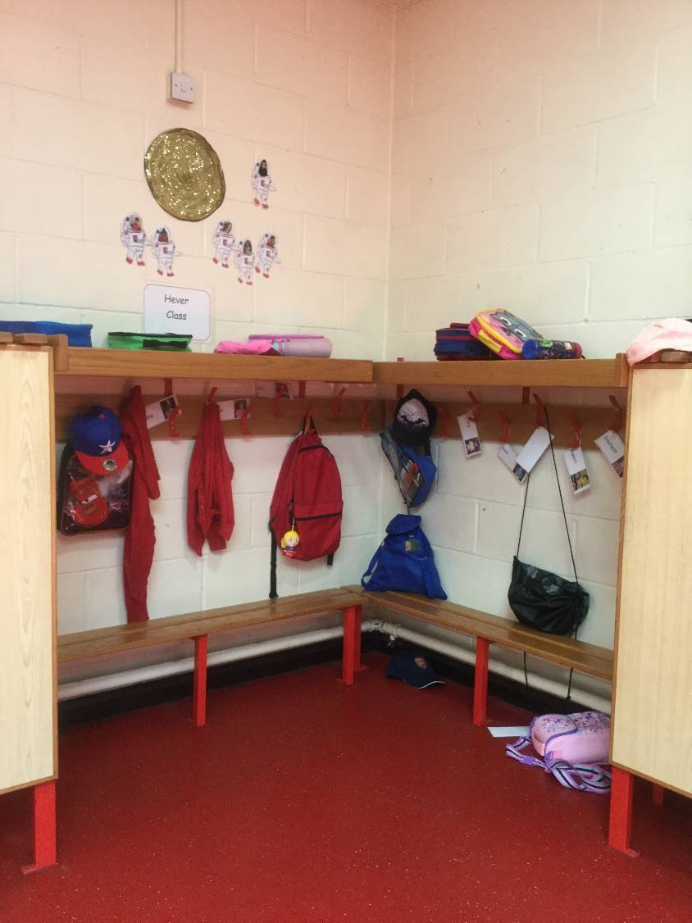
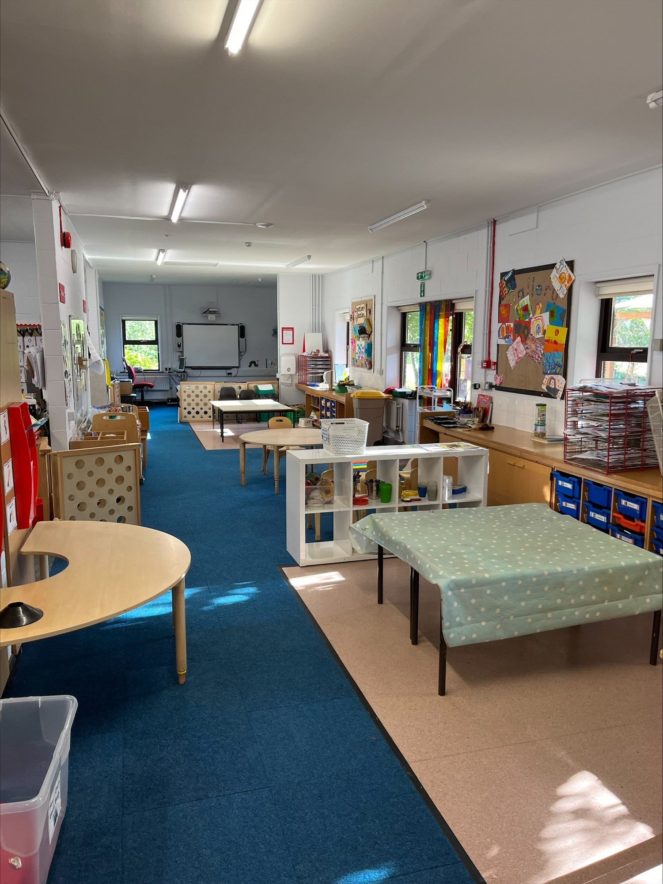
The cloakroom
Shared Area

Slide 22
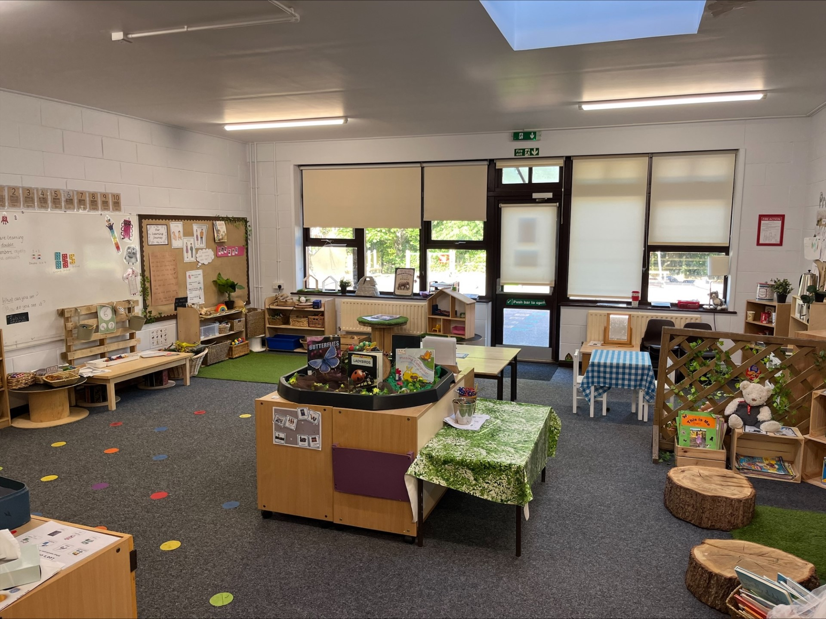
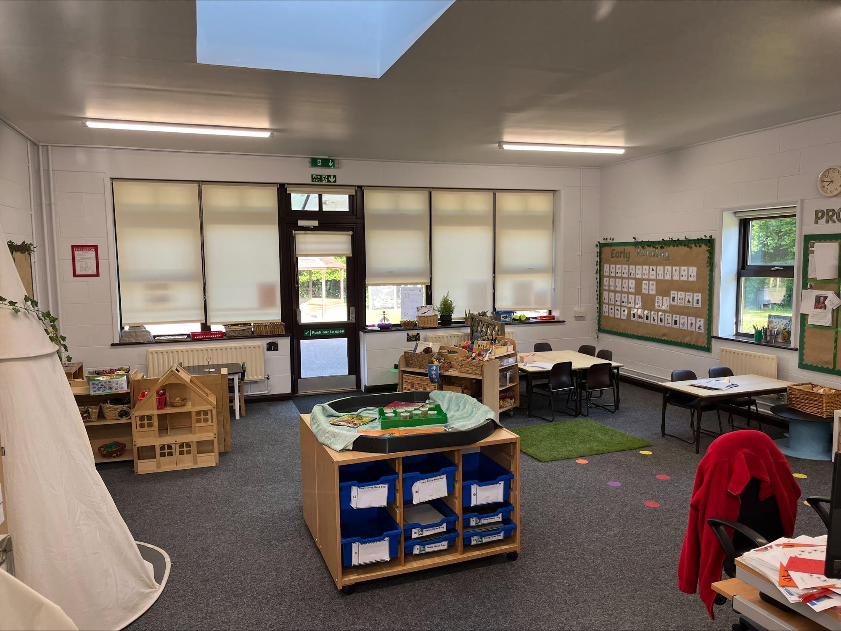
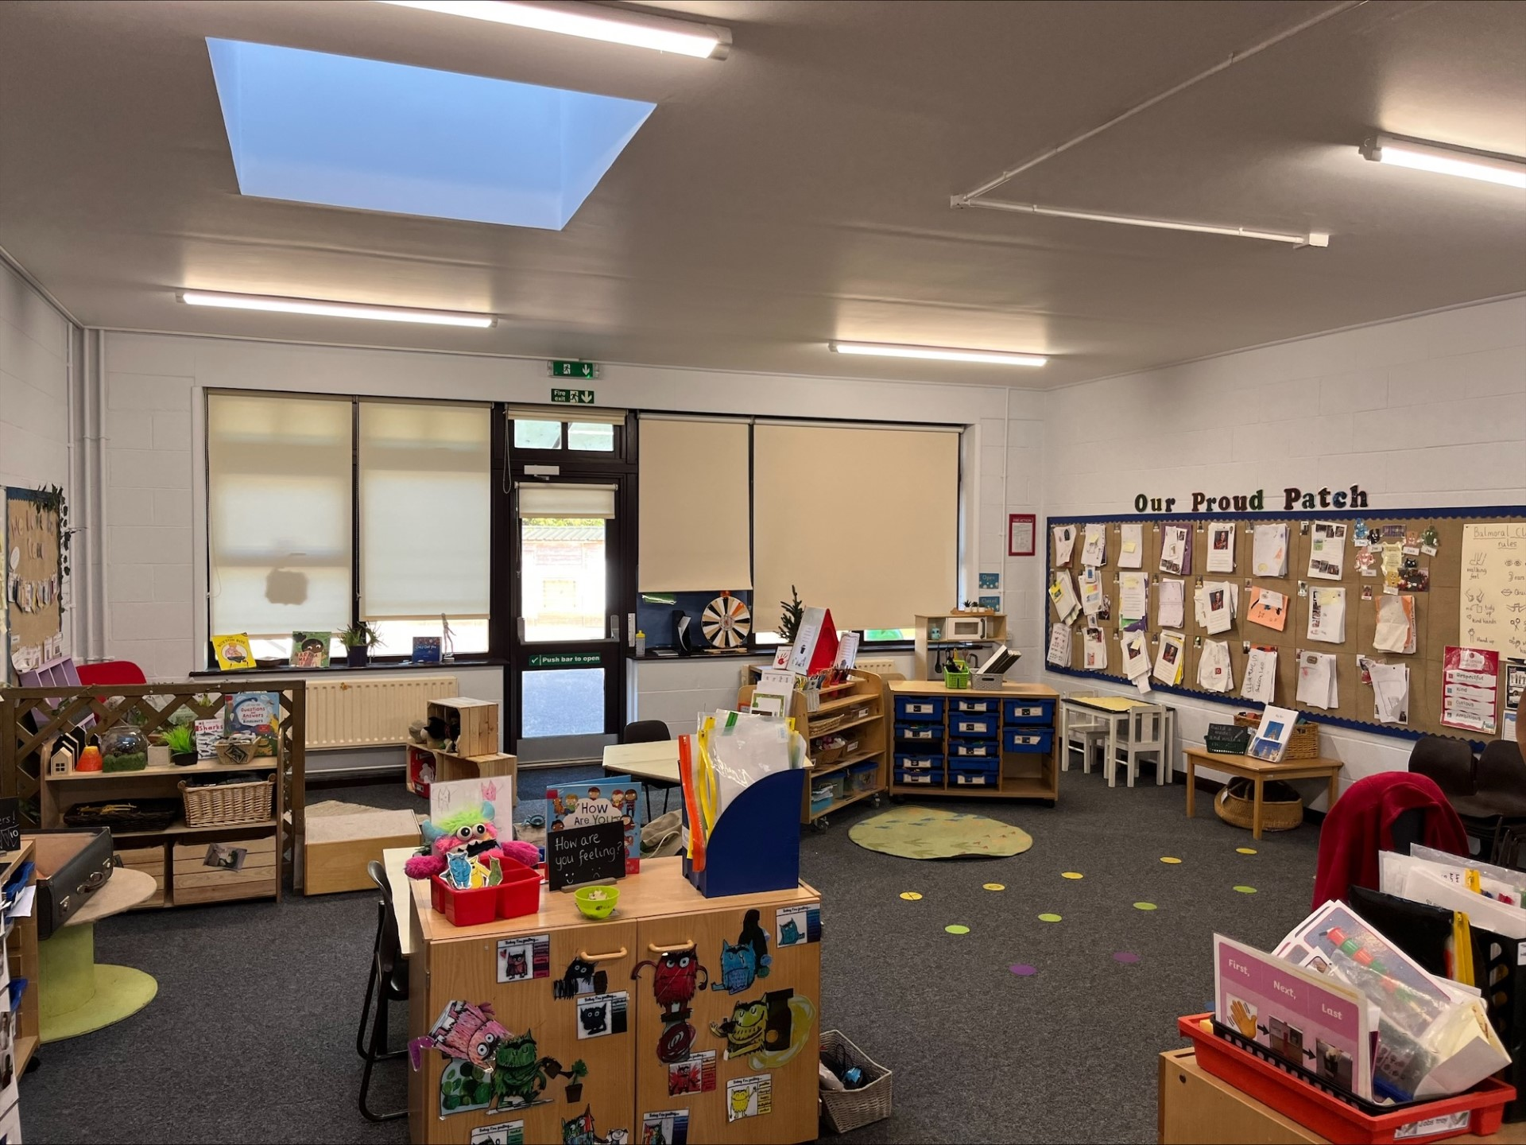
The classrooms and shared area
Hever Class
Amberley Class
Balmoral Class

Slide 23
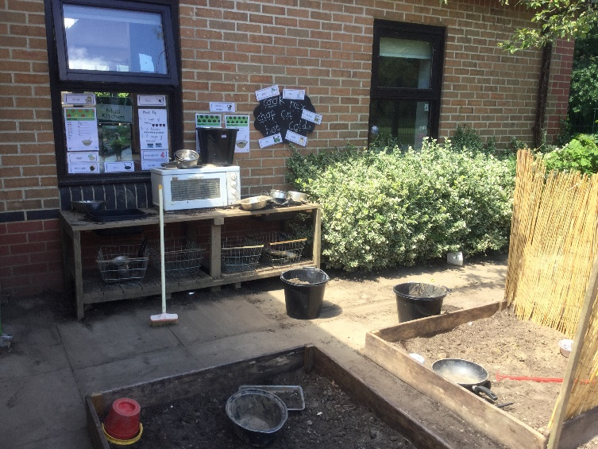
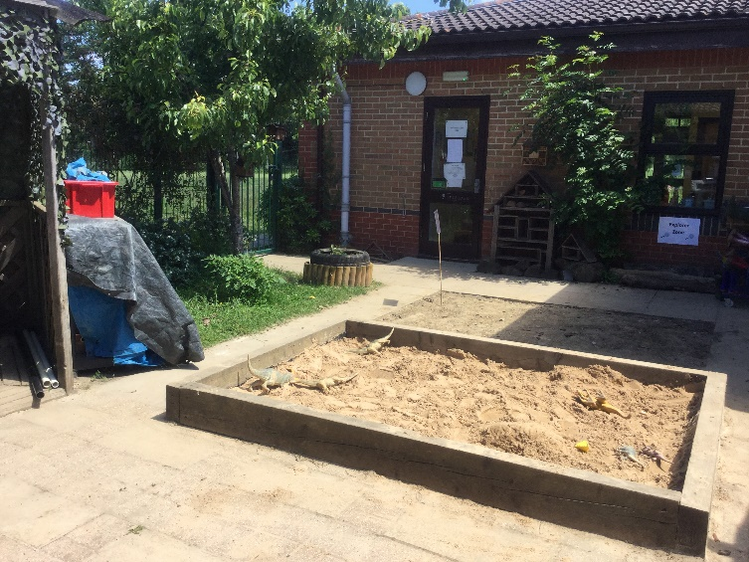
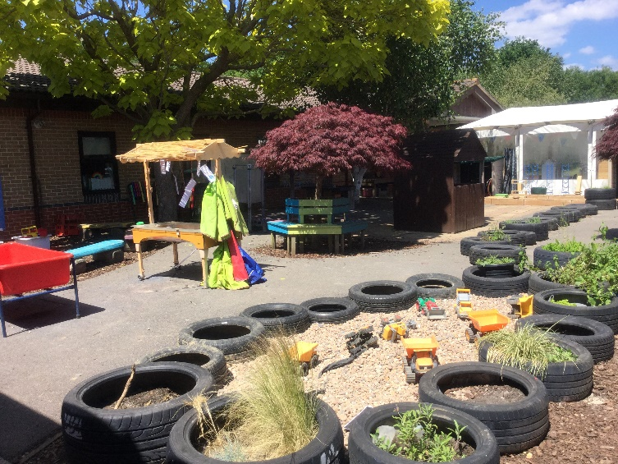
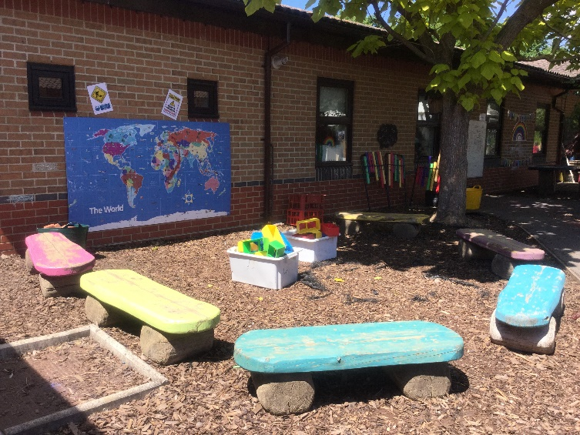
The Learning Garden

Slide 24
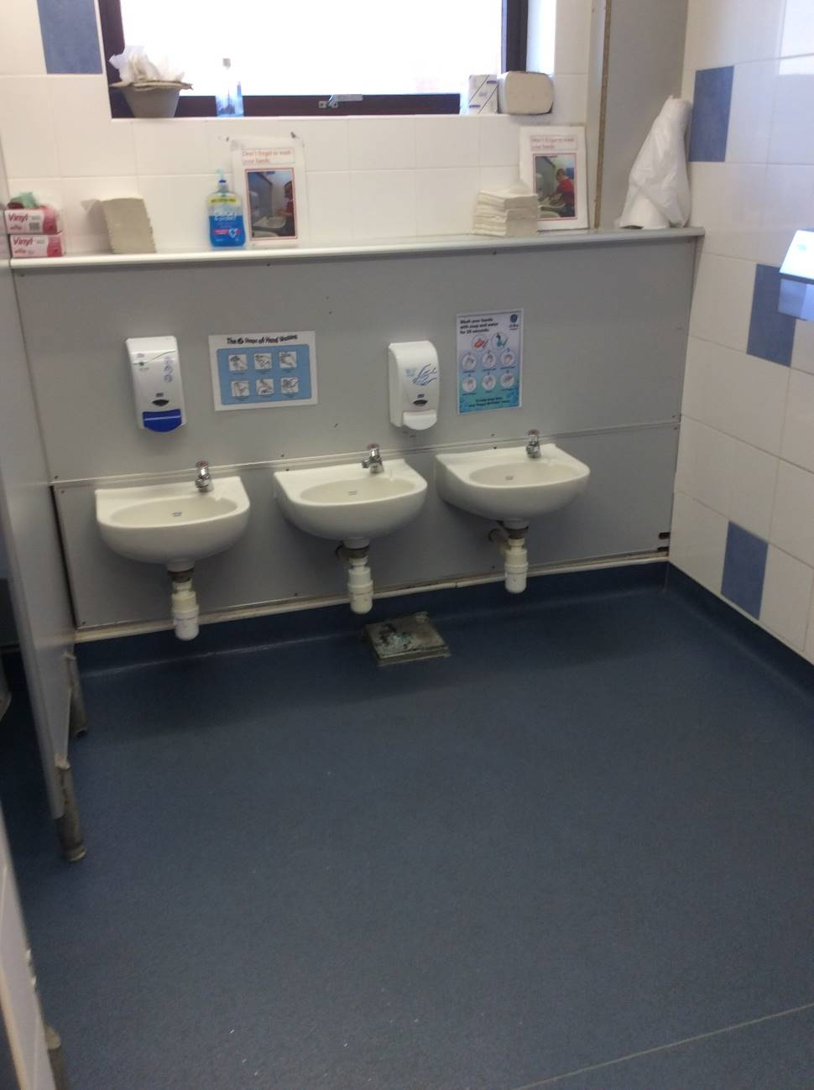
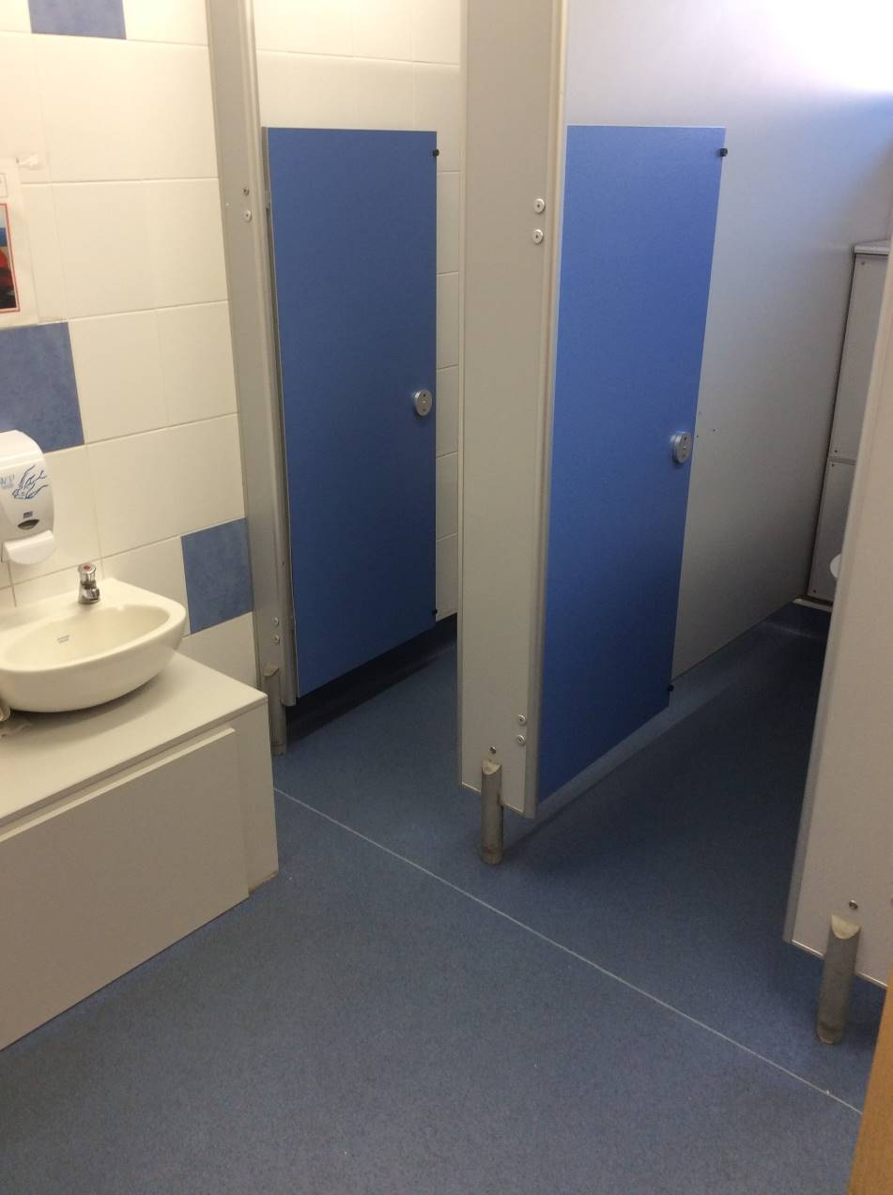
The toilets

Slide 25
Inclusion
Role of the Inclusion Lead
What if you have any worries or concerns?
Partnership with Parents
Support and services available
How to contact Mrs Tomlinson
School main number on 01293 886324 or email office@maidenbowerinfant.w-sussex.sch.uk

Slide 26
Pupil Premium
If you think you may be eligible for a pupil premium grant, please pick up a form from the office.
More information on the government website:
https://www.gov.uk/government/publications/pupil-premium/pupil-premium

Slide 27
PTA 24/25
Magician
£190
23/24
Each Year Group £500
Nursery £200
Fireworks
£6,100
School Lottery
£430
Forest School
£80
X-mas Cards
£127
Junk Orchestra
£600
Christmas Fair
£1,500
24/25
YR & Y1 £1,260
Nursery £504
Bingo
£180
Asda
£90
Ipad Cases
£540
Ipad Charging Trolley
£1,200
Paint & Sip
£140
Summer Fair
20th June
Krispy Kreme
£54
Drumming Y2
£1,200
Silent Disco
£400

Slide 28
Any questions?
Please feel free to contact the school office and we will do our best to answer your queries or worries.

