Slide 1
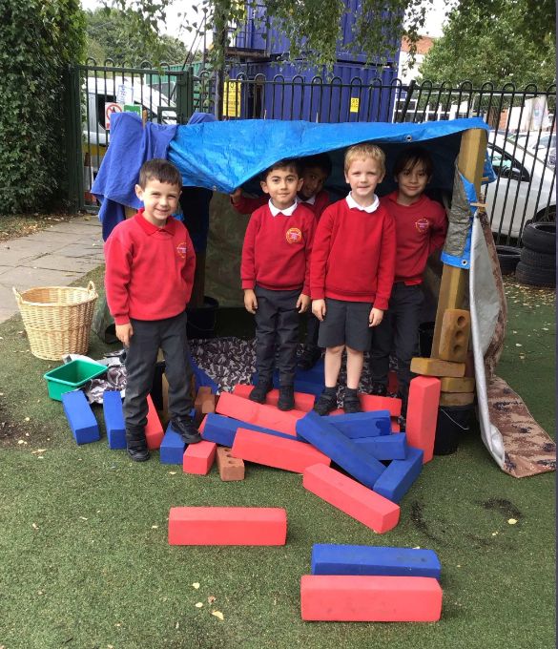
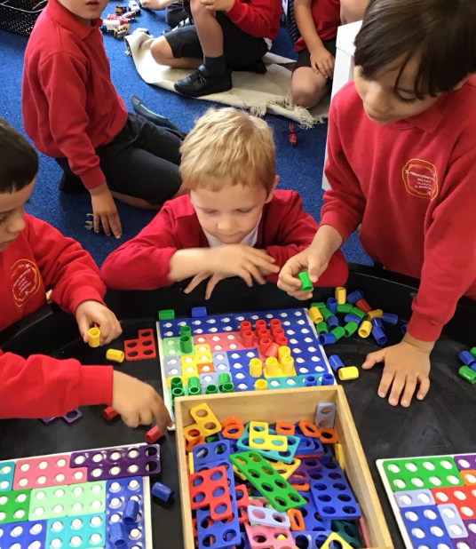
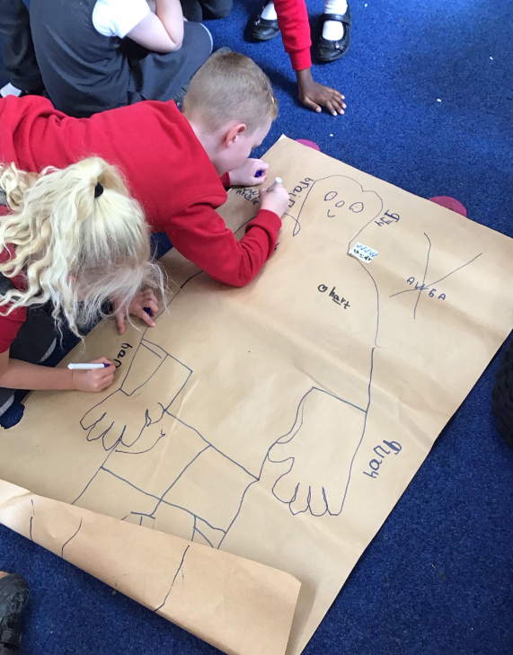
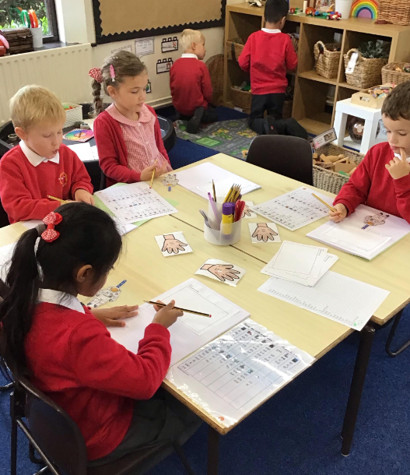
Welcome to Year One

Slide 2
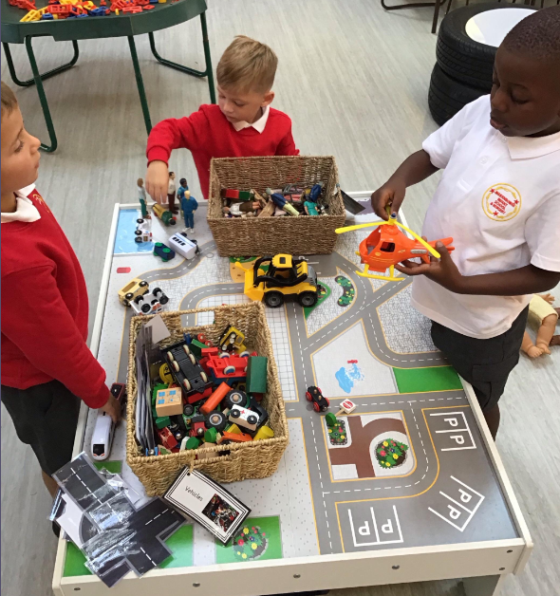
What we will cover in this meeting…
Life in Year One
Reading diary + Journey to Pluto
Challenge us
PE days
Topics and enrichment
Help please!
Walk around the unit and questions

Slide 3
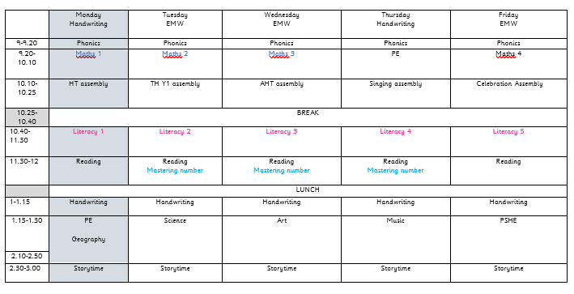
A typical day in year one

Slide 4
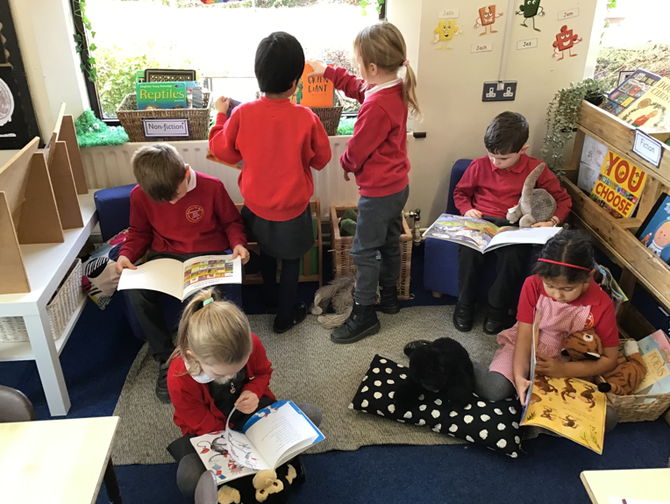
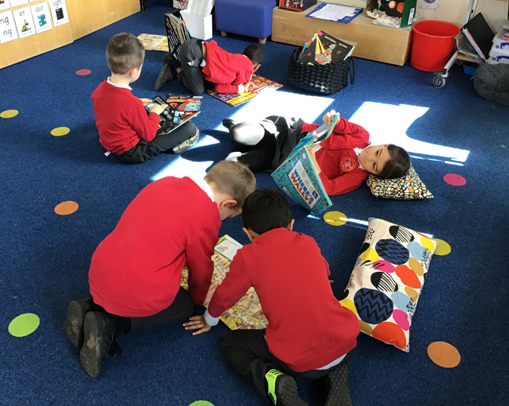
Reading diary + journey to pluto
Please give your child a range of reading experiences, read to them as much as they read to you.
Talk about the pictures and draw out the language through your discussions before they read.
Number the books you read at home and once you have reached Pluto, notify your class teacher
We will read with the children in school 3 times per week and will change their phonics book on their first read. They can also select their own book from our book corner
There is a Phonics Workshop for parents on Wednesday 24th September at 2pm if you would like to come and find out about how we teach phonics

Slide 5

Challenge us
Similar to Reception, Year 1 children will have a ‘Challenge Us’ will be set every Friday
The Challenge Us will review learning from the week and may include revisiting prior learning
You may share any home learning on your child’s Dojo portfolio – we love to share any posts with the whole class
In Year 1, we don’t tend to post in your child’s portfolio as they have books to record learning

Slide 6
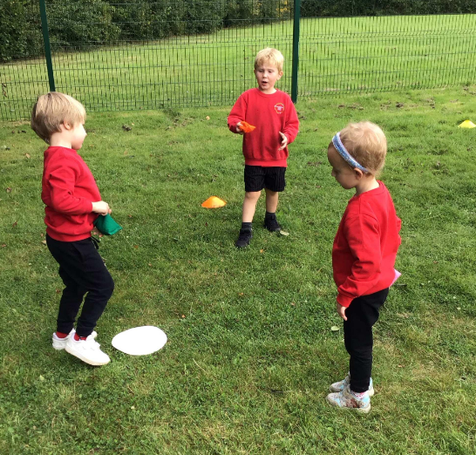
PE days
Pembroke & Bodiam class will have PE on Monday and Thursday.
Windsor class will have PE on Wednesday and Thursday.
Children need to come to school to wearing their PE kit. Please tie up long hair and remove earrings or cover with tape before coming to school. Staff are not able to do this in school and your child will not be able to join in with the session if they have uncovered earrings.
On Monday/ Wednesday, we will have PE outside. Please ensure that children are dressed suitably for this session as we will go out unless there is very extreme weather!
We will teach gymnastics, dance, ball skills, athletics and field games over the course of the year

Slide 7

Topics

Slide 8
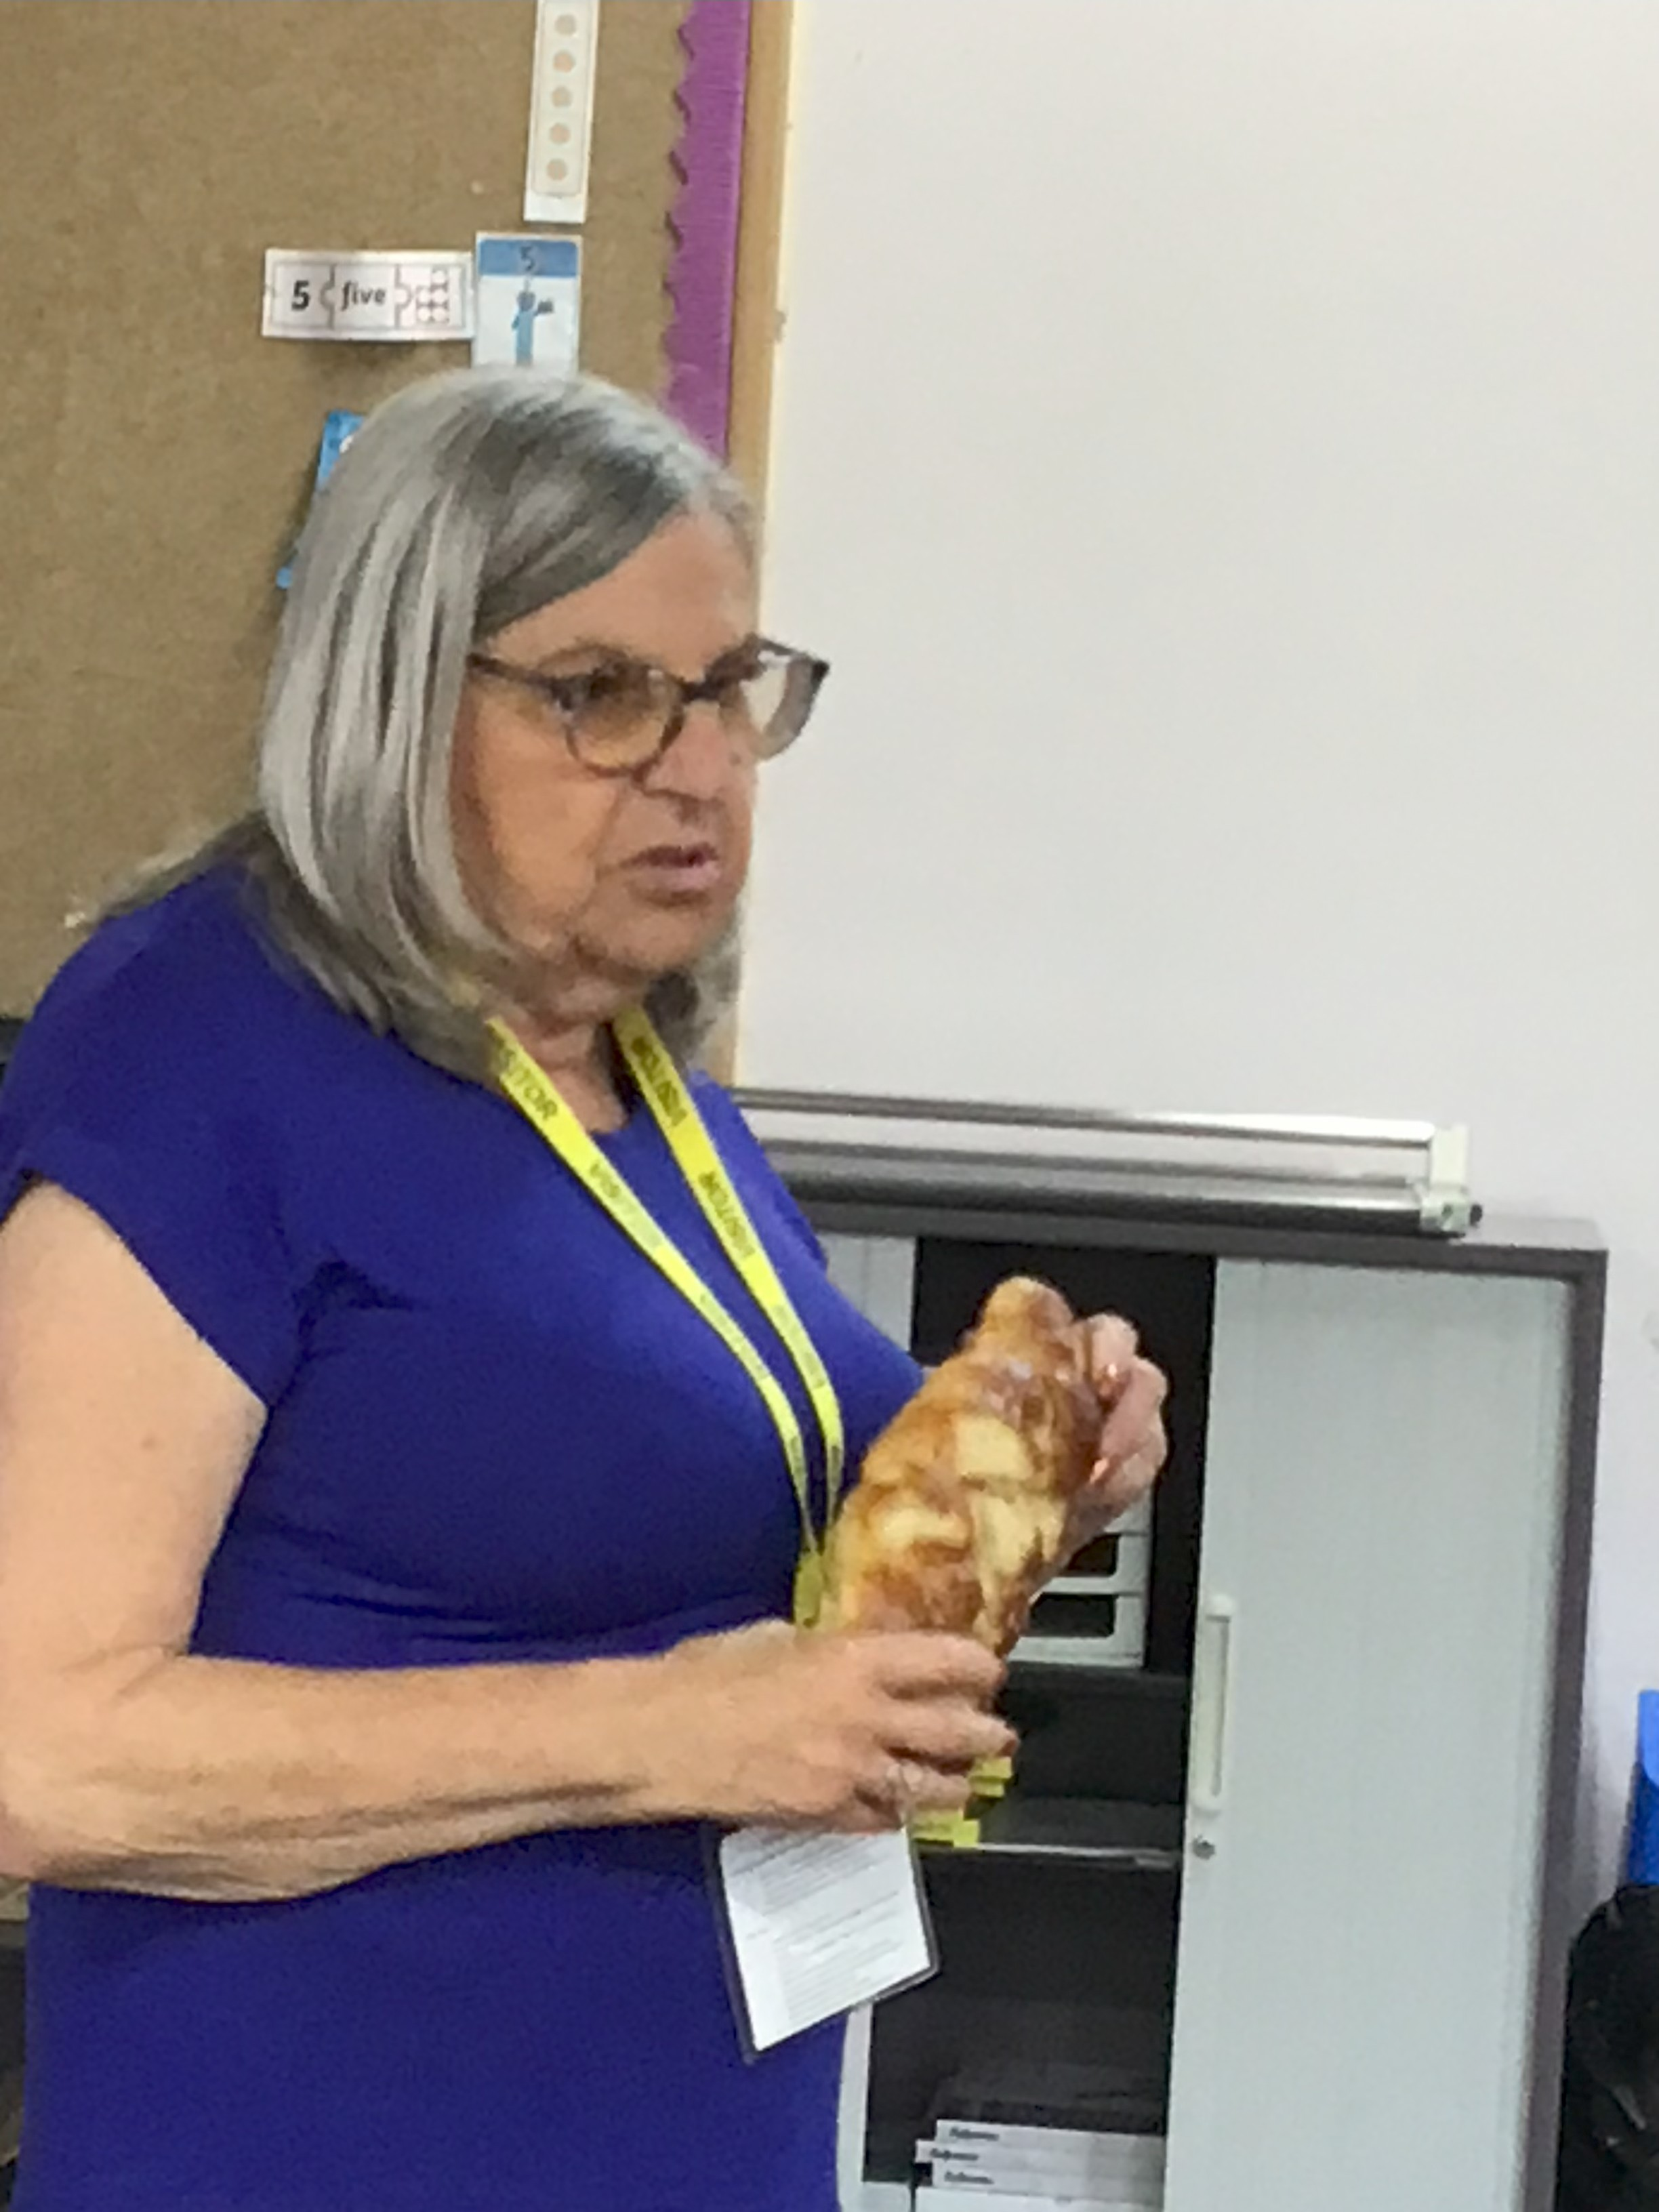
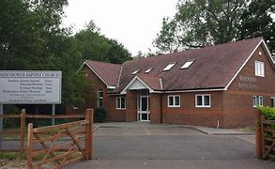
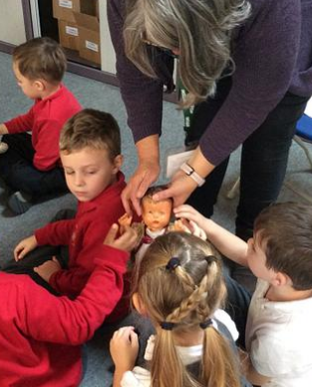
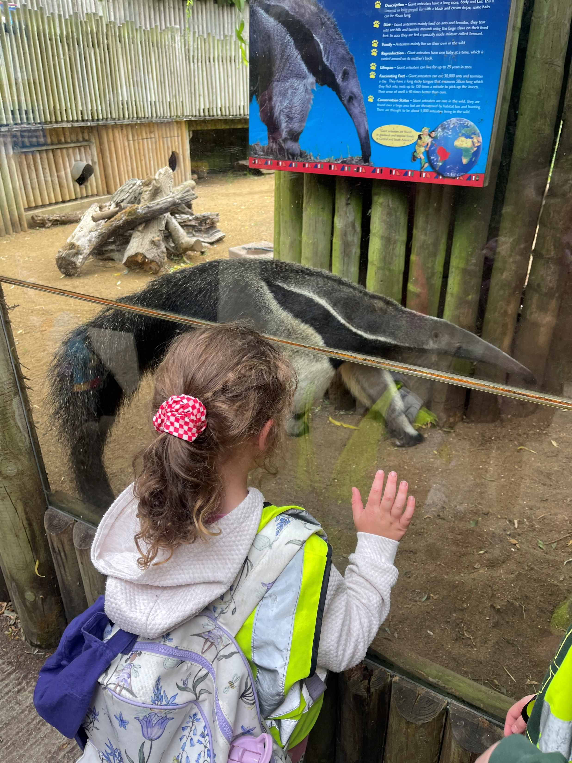
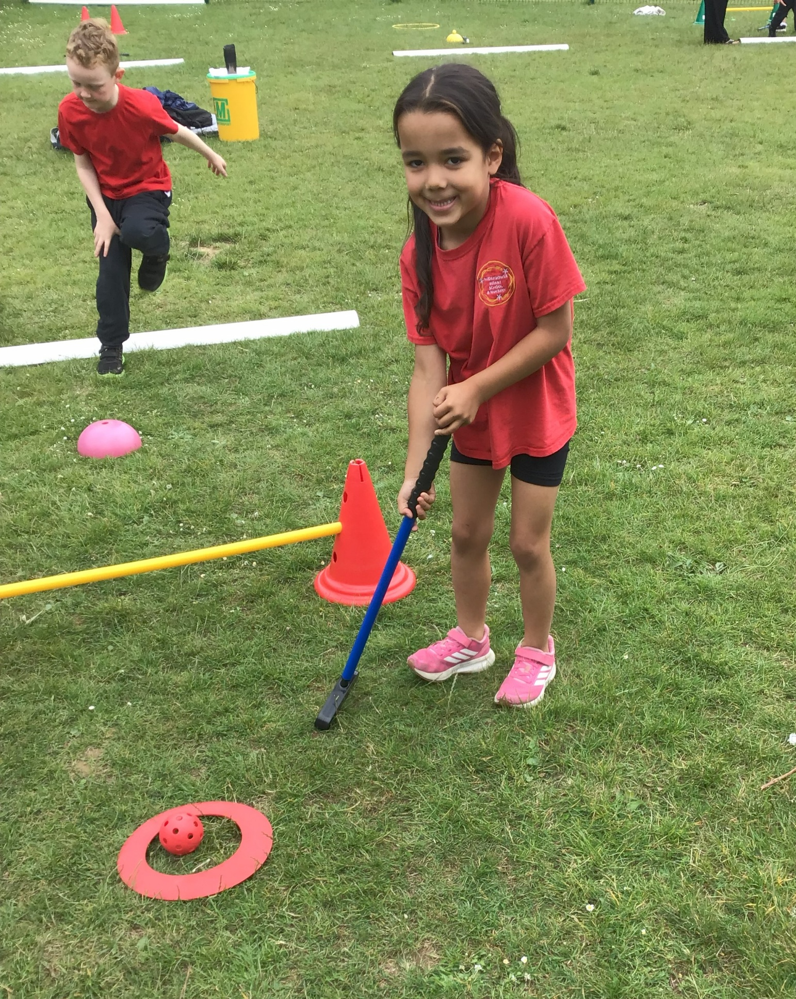
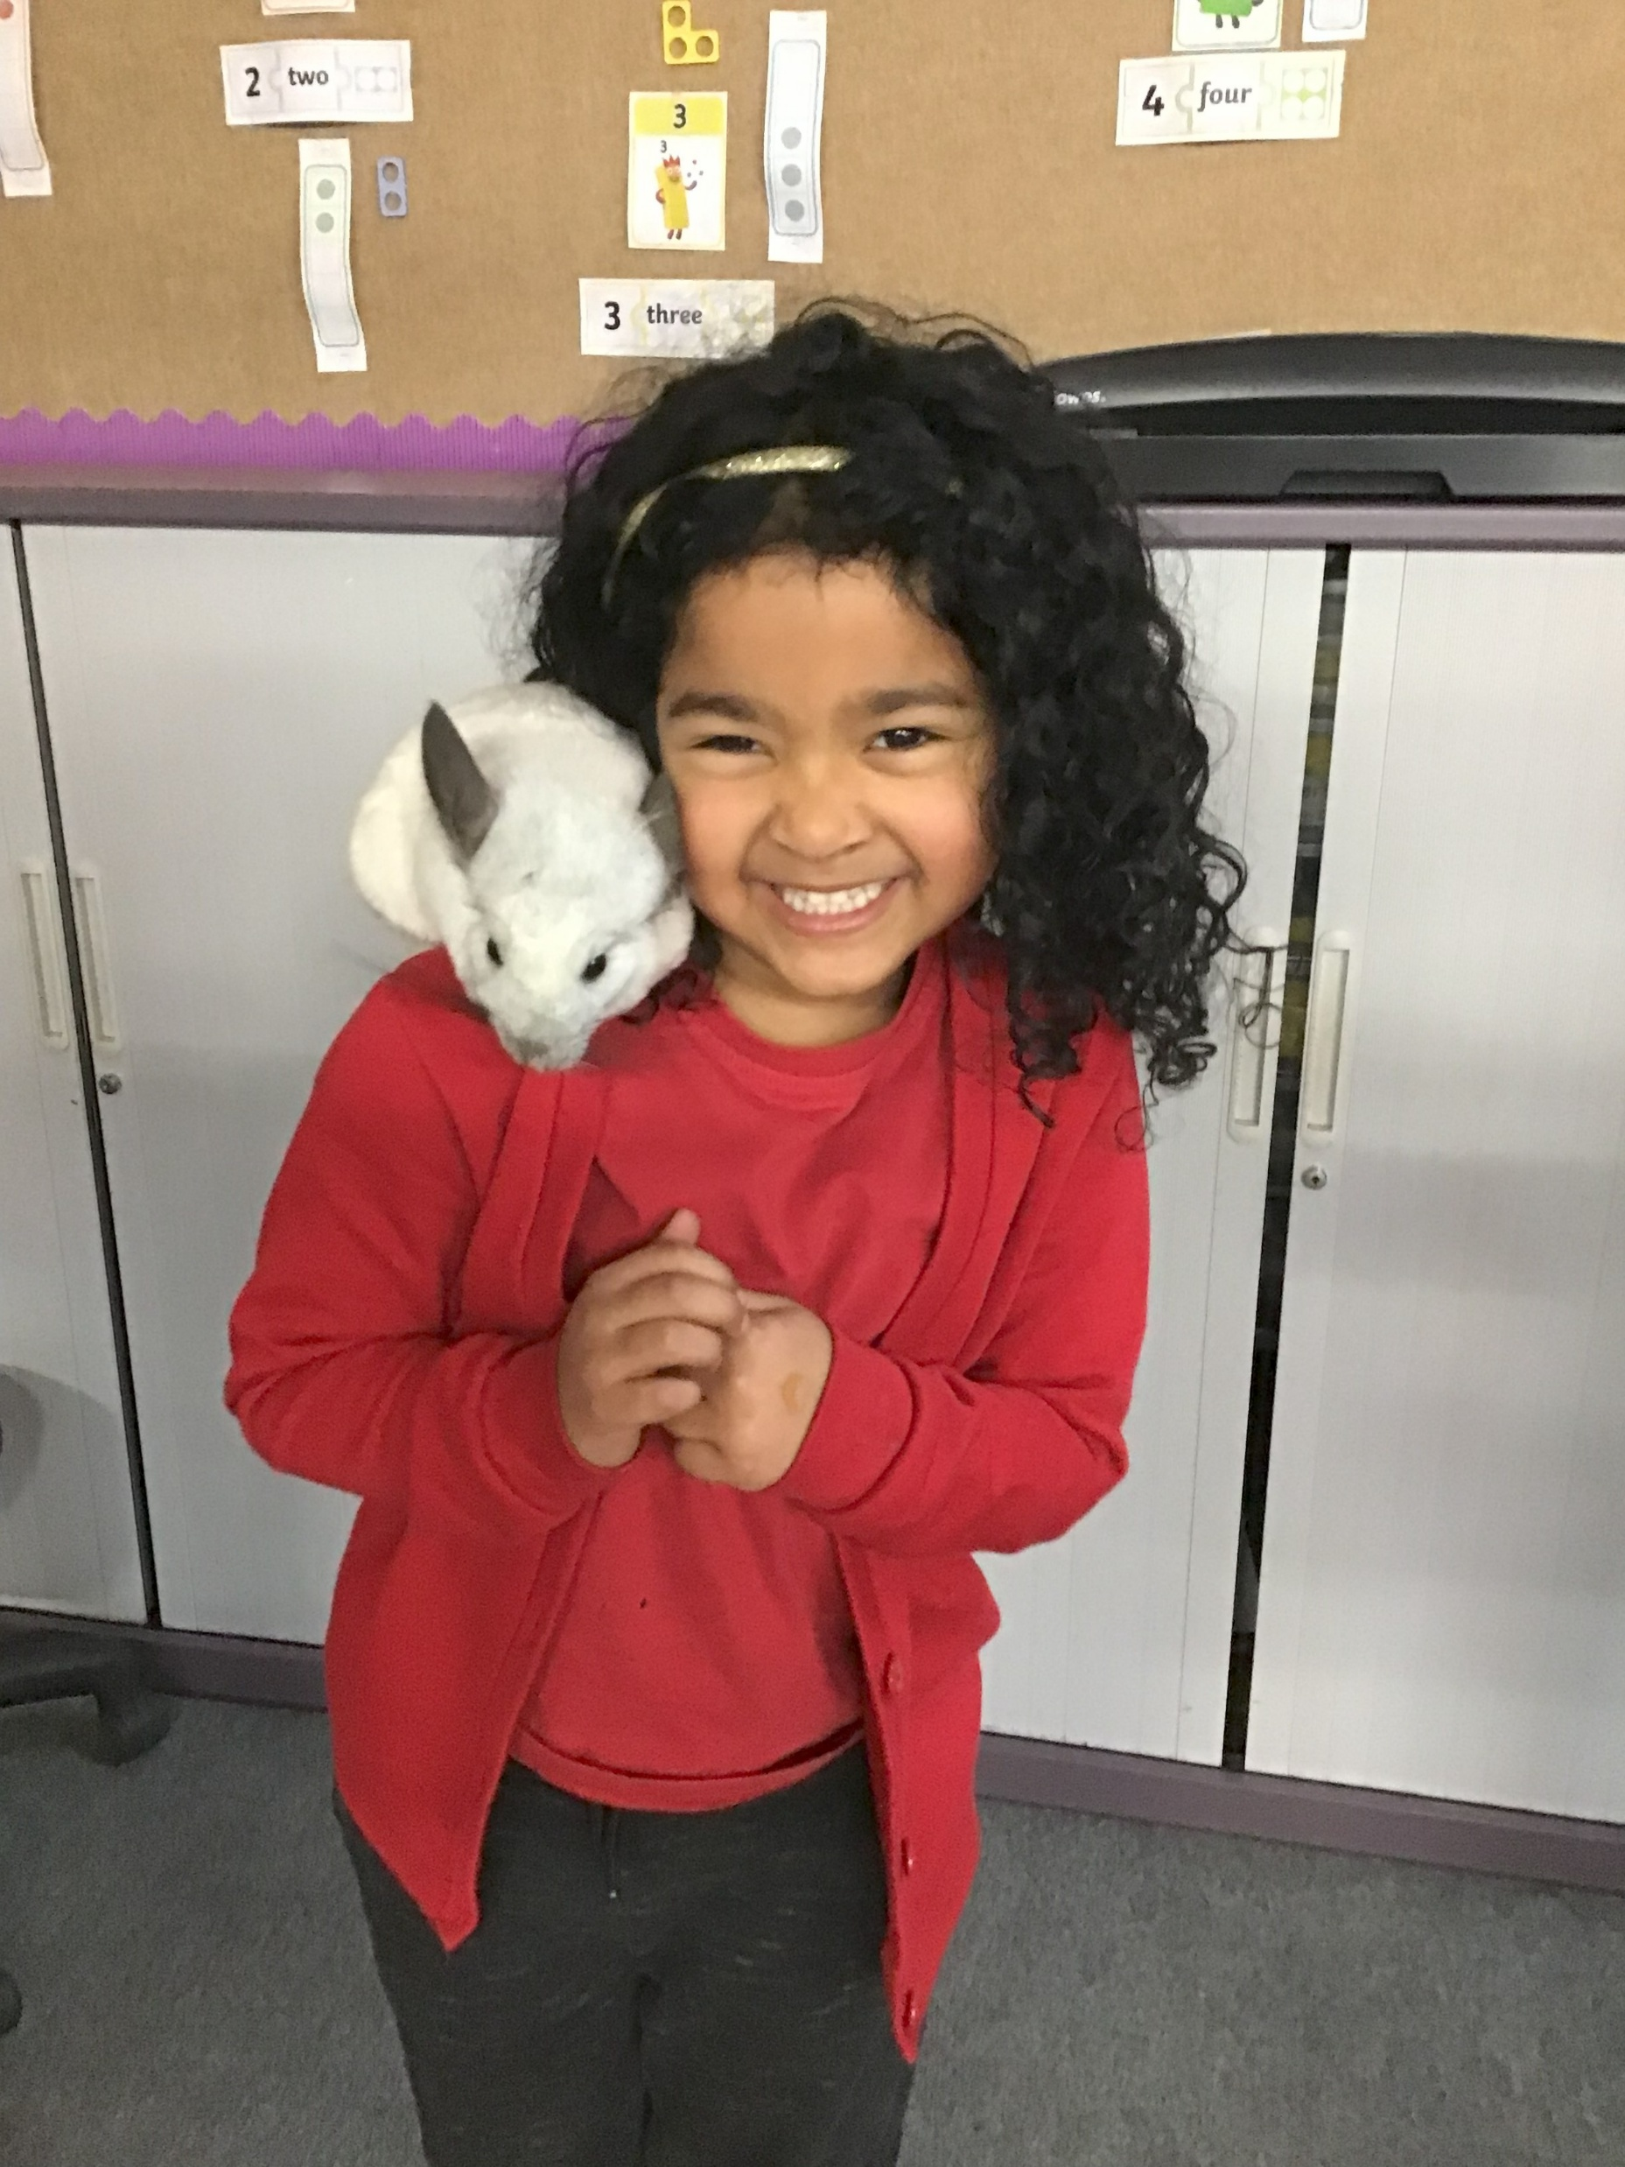
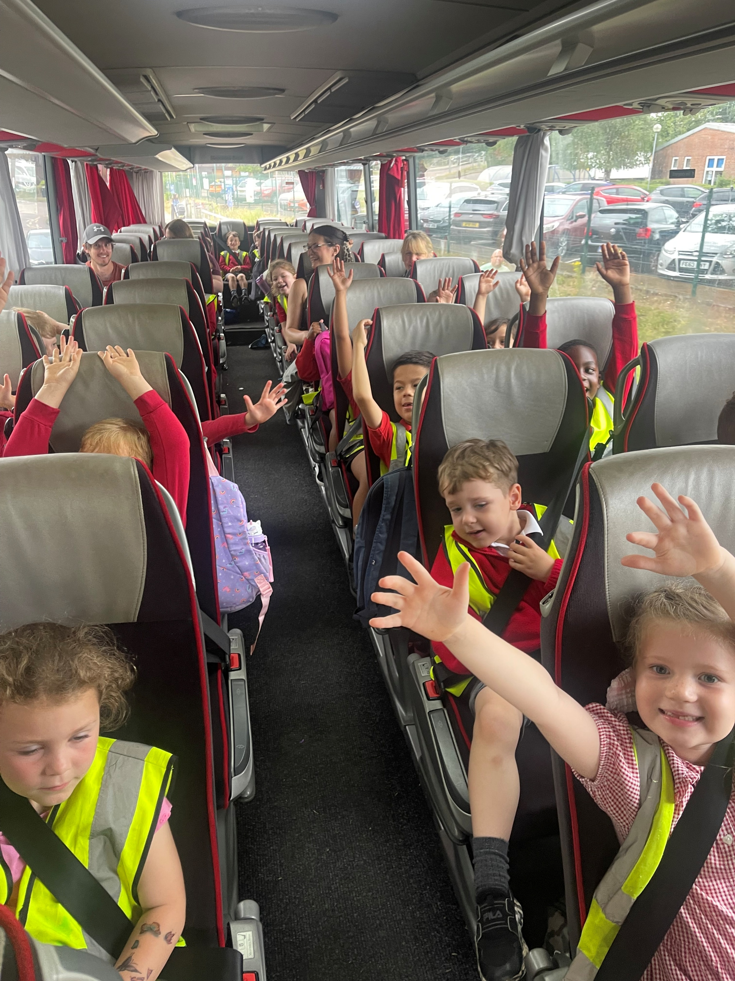
enrichment activities

Slide 9
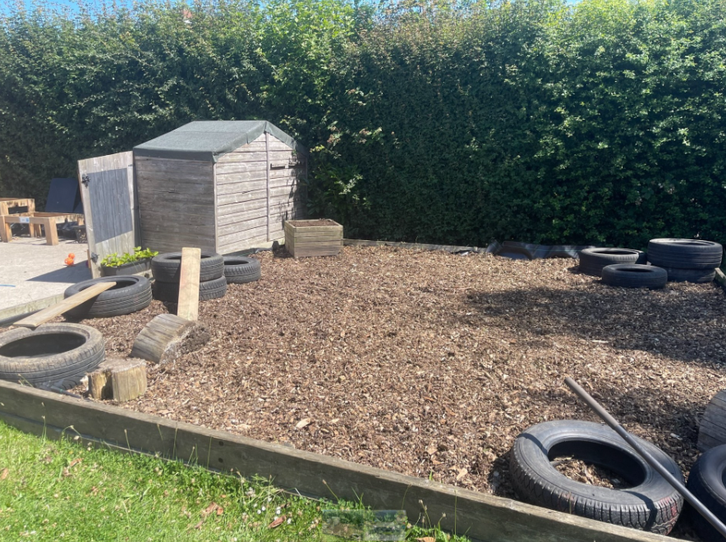
help needed!
We are always on the lookout for parent helpers to support staff with admin tasks, to read with children and help with tasks in provision. Please let me know if this is something you might be interested in.
On Monday 22nd September, we will be going for a walk around Maidenbower. If you would like to volunteer and support us on this walk, please let us know.
We need your support with keeping our learning garden tidy at the end of the day. We tidy away and set up for the next morning so please do not allow your children to play after 3pm.

Slide 10
Walk around the class and questions
You are welcome to look around the classroom and shared area and ask me any questions about life in Year 1. If you have any questions directly related to your child, please arrange this for another date as we are short on time this evening!
Please leave through the outside door in the cloakroom by 5:30pm at the very latest.
Thanks for coming!

