Slide 1

Welcome!
Ofsted said:
Pupils arrive every day excited and eager to meet their friends in this caring and happy school. Relationships between staff and pupils are warm and respectful.
The atmosphere around classrooms and corridors is calm and harmonious. The school values of curiosity, respect, kindness and ambition are part and parcel of everyday life.
Pupils feel safe. Playtimes are happy occasions. For example, older pupils set up games for others to enjoy. Pupils take time to relax in the sensory den and outdoor reading area. They are clear that staff deal with any incidents of bullying or poor behaviour quickly.
While you wait, consider your answer to the question.
What positives did you notice in the report?

Slide 2
What will we cover?
Introductions
The background of the school
Gradings
The future
Questions

Slide 3
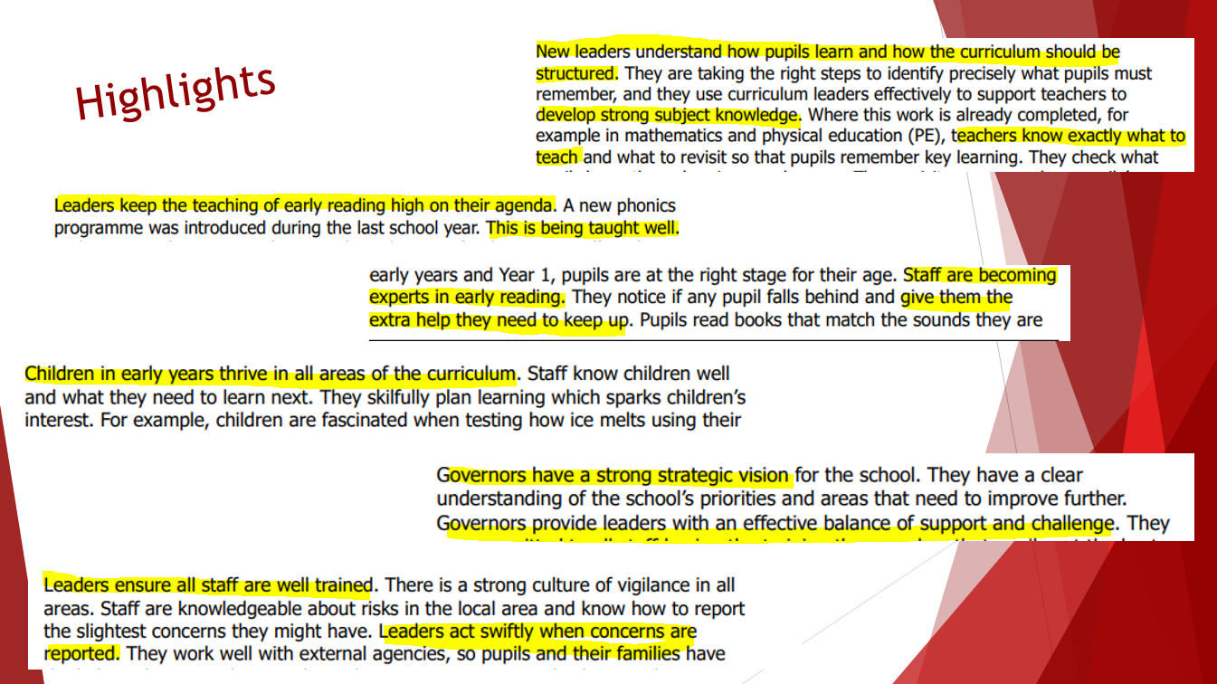

Slide 4
When were we last inspected by Ofsted?
17th September 2009
DFE 22nd November 2022:
From 2012, schools that had been judged outstanding were legally exempt from further regular inspection, unless there were specific concerns about the school. The exemption was lifted in 2020.
Today’s commentary notes that over 80% (308) of these schools that had a graded inspection last year did not retain the outstanding grade. The majority were judged to be good. However, around a fifth were rated requires improvement (17%) or inadequate (4%).
Ofsted’s Chief Inspector, Amanda Spielman, said:
Regular inspection gives parents confidence in the quality of their child’s school. Exempting outstanding schools deprived parents of up-to-date information. It also left a lot of schools without the constructive challenge that regular inspection provides.

Slide 5
The exemption was a policy founded on the hope that high standards, once achieved, would never drop, and that freedom from inspection might drive them even higher. These outcomes show that removing a school from scrutiny does not make it better.
What can impact the quality of education?
Changes in leadership of the school
Lack of a clear vision or direction for the school
Changes to the Ofsted Framework
Large staff turnover
Low pupil numbers/funding
Quality of education/lack of quality professional development
Periods of lockdown
Staff morale
No support from local schools or local authority

Slide 6
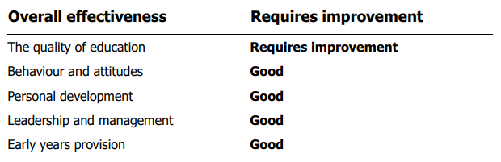
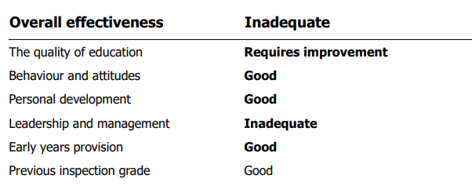
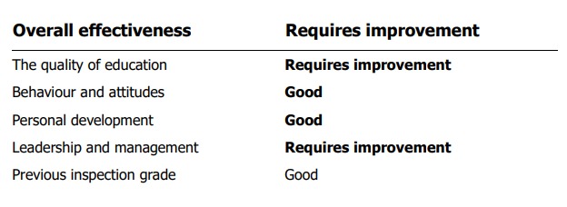
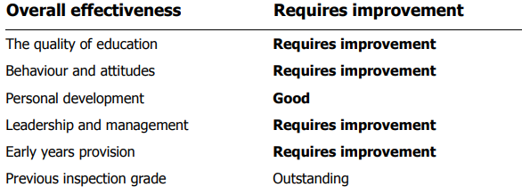
MIS

Slide 7

What are our priorities?
What does the school need to do to improve?
◼ In some areas of the curriculum, leaders have only recently determined the exact progression of knowledge and skills. As a result, pupils are not always able to remember previous learning and make links with new learning. Leaders should continue with their work to make sure that teachers know what and how they should be teaching in all subjects.
◼ Some older pupils did not experience a high-quality early reading curriculum when they started school. They do not read with the fluency and comprehension expected for their age. Leaders should continue to ensure expert support for all pupils so they can read well enough to access the curriculum.

Slide 8

What are the main changes we have made?
New vision, values and motto
Sharing life in school (Dojo) and social media presence
Introducing a weekly newsletter
Key dates are shared
New website
Phonics scheme in place and being taught well
Reading books link to Phonics phase for all children
EYFS approach to provision
Yr 1 approach to provision and learning
Developing leaders across the school
Consistency in teaching and learning across the school
Professional development for all staff
Training for staff about how to meet all children’s needs
Overhaul of curriculum and school trips

Slide 9
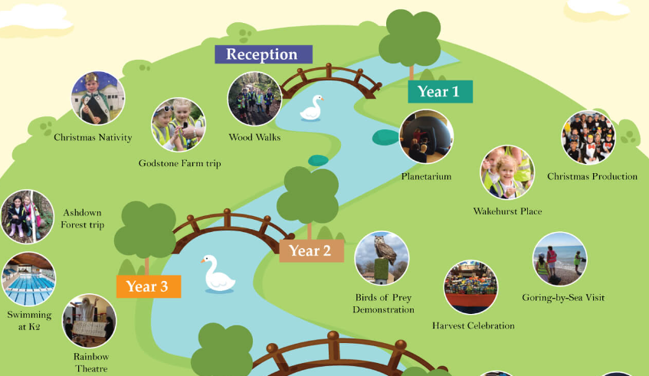
What does the future hold?
Closing the gaps between pupil achievement
Achievement above National averages for RWM/Phonics
Clear overview for each year when trips and visitors
will take place
More parental involvement
Ensuring all basic skills are in place ready for junior school
Our PSHE curriculum prepares children for modern day Crawley
Develop IT equipment
Increase forest school provision from one afternoon to 3 days
Continue to develop our enrichment activities for children

Slide 10
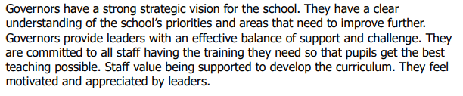
Questions?
Considering the Requires Improvement grade for the quality of education given in the Ofsted report, I would like to know how the governing body are going to hold Mrs Roberts to account with regards to the educational performance going forward.
Why has the school fallen from top ranking to bottom ? Although turbulent years were observed, most UK schools were affected by similar circumstances, but yet managed to keep the qualifying of education provided and adhere to high teaching standards and end of year results. How can parents be sure their kids are getting the best education to highest standards in this school and why (reasons) not to move to better rated schools?
      Leaders keep the teaching of early reading high on their agenda. A new phonics programme was introduced during the last school year. This is being taught well. In early years and Year 1, pupils are at the right stage for their age

